Slide 1

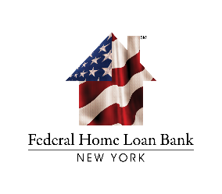
Presentation to New York State Rural Housing Coalition Preserving Homeownership: Funding for Affordable Housing
October 25, 2025

Slide 2
Overview of AHP General Fund
What is the AHP General Fund?
The Affordable Housing Program (AHP) General Fund provides funding to purchase, rehabilitate, or construct affordable housing
Rental projects and homeowner projects are both eligible for the AHP General Fund
AHP subsidy is funded as a reimbursement; projects will need to demonstrate sufficient cash flow during construction
Who can apply to the AHP General Fund?
AHP funds may only be accessed through a participating FHLBNY Member Financial Institution (Member)
Members partner with a sponsor (government entity, not-for-profit, or for-profit organizations) who will lead the project and manage the grant with FHLBNY
2026 AHP General Fund Round Key Dates and Parameters
The round will launch on February 9, 2026
Maximum of $80,000 per AHP targeted unit
Maximum of $2.5 million per project

Slide 3
Project Eligibility
Use of funds for acquisition, construction, or rehabilitation
Project sponsor must demonstrate site control
Demonstrate project feasibility via development and operating budgets
Demonstrate need for AHP subsidy
Rental Housing Only -
Minimum 20% of the units must be reserved for households that earn 50% or less of the area median income
Owner-Occupied Housing Only
All units for households earning 80% or less of the area median income
Sponsors are limited to 25 units of Owner-Occupied Rehabilitation per AHP General Fund round

Slide 4
Project Scoring
Use of donated or conveyed government-owned or other properties: 5 pts
Sponsorship by a not-for-profit organization or government entity: 7 pts
Targeting: 20 pts
Underserved Communities and Populations: max. 12 pts
Homeless Households: 6 pts
Supportive Housing in Rental Projects: 6 pts
Extremely Low Income: 6 pts
Projects in U.S. Territories: 6 pts
Native American Tribal Housing Initiatives: 6 pts
Creating Economic Opportunity: Residential Economic Diversity: max. 10 pts
Mixed Income Housing: 5 pts
High Opportunity Area: 5 pts
Community Stability: Preservation of Affordable Housing: 10 pts
District Priorities: max. 36 pts
Project Readiness: 10 pts
Owner-Occupied Projects: 5 pts
Small Projects: 5 pts
In-District: 5 pts
Green Building Innovation: 5 pts
Member Financial Participation: 6 pts
AHP Subsidy per Unit: 5 pts

Slide 5


ABOUT US
501(c)(3) Nonprofit
RUPCO is the Hudson Valley region’s leading provider & advocate of quality, affordable housing and community development programs aimed to provide opportunity and revitalize communities.

Slide 6
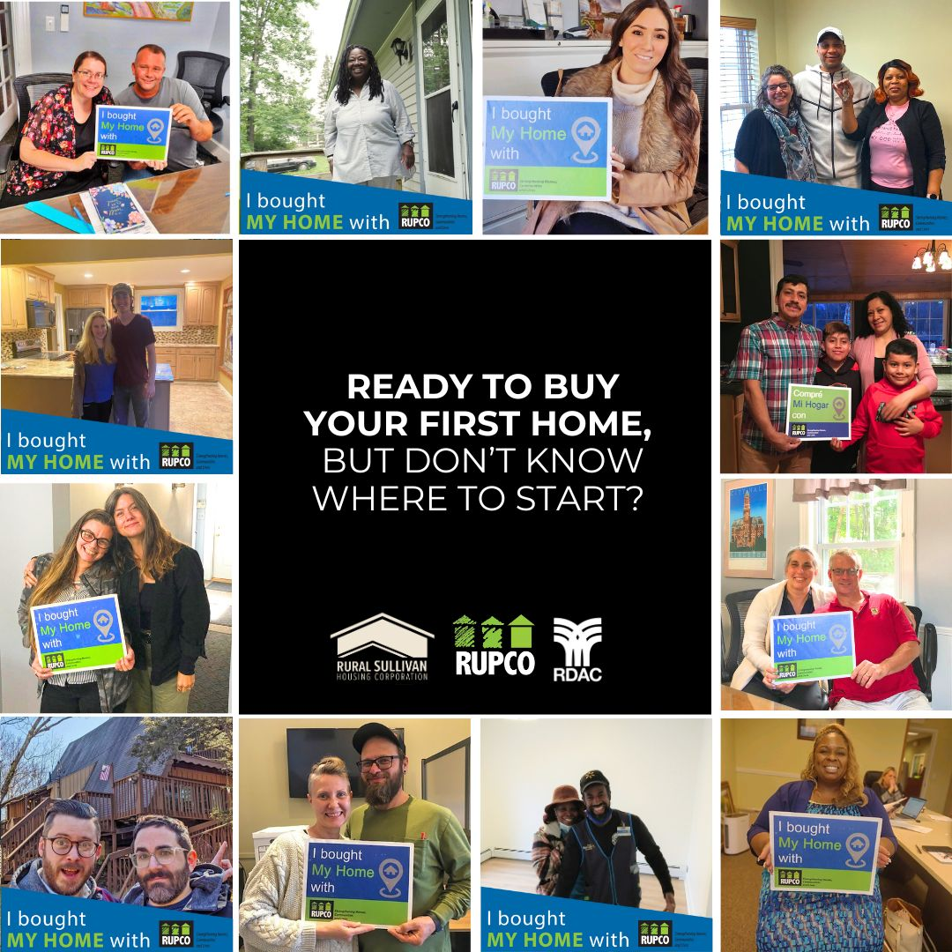
OUR MISSION
Create homes,
Support people and Improve communities.

Slide 7
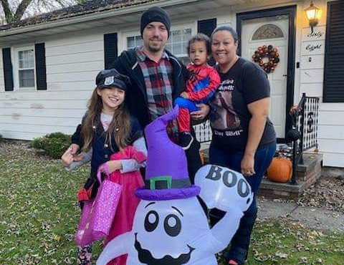


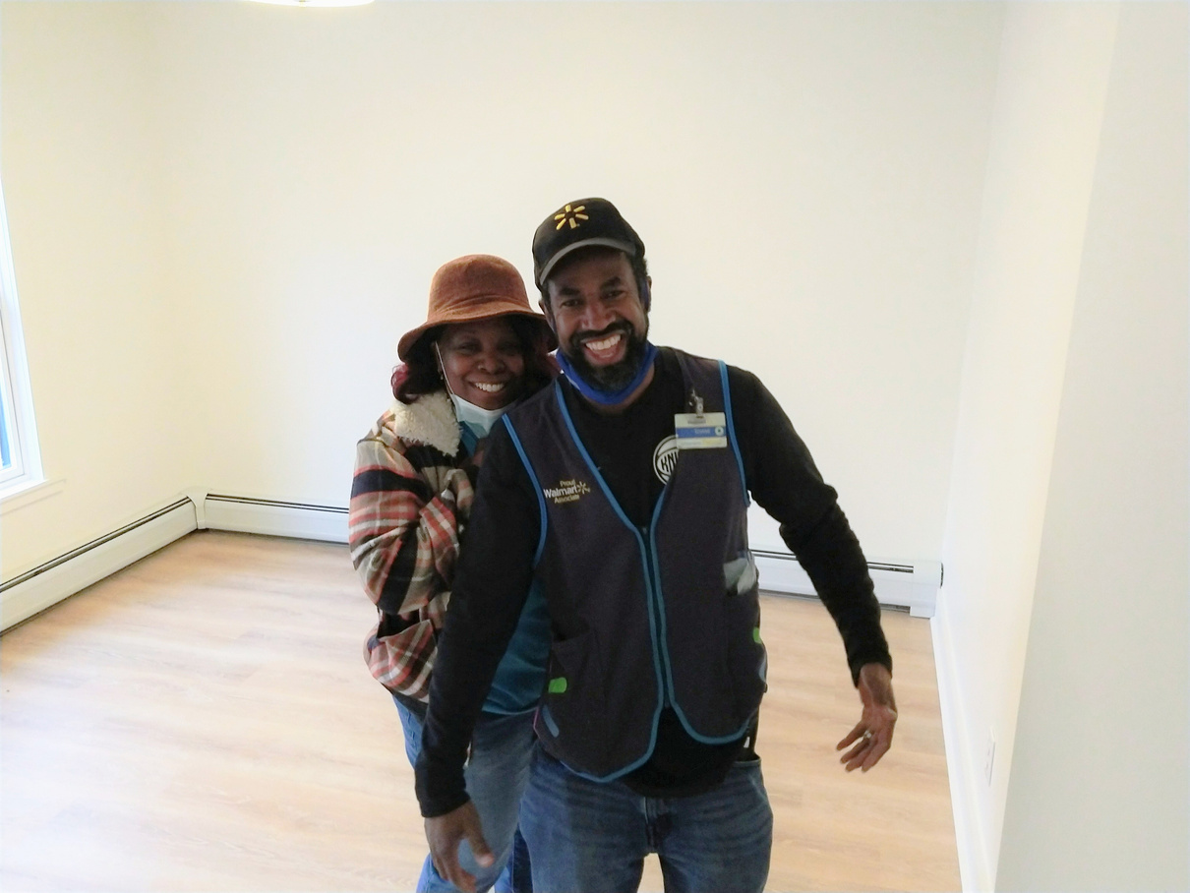
HOMEBUYER
SERVICES
Homebuyer information sessions.
First-time homebuyer counseling, including credit review and mortgage-ready analysis.
Homebuyer education classes
Grants to assist first-time buyers with down-payment, closing costs, and repairs when available
(eligibility is required) - 8 FHLBNY $1,330,446 in mortgages

Slide 8
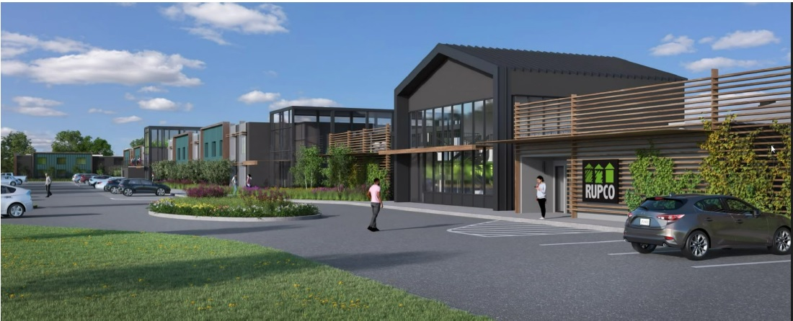
RTE. 28
APARTMENTS
Town of Ulster

Slide 9
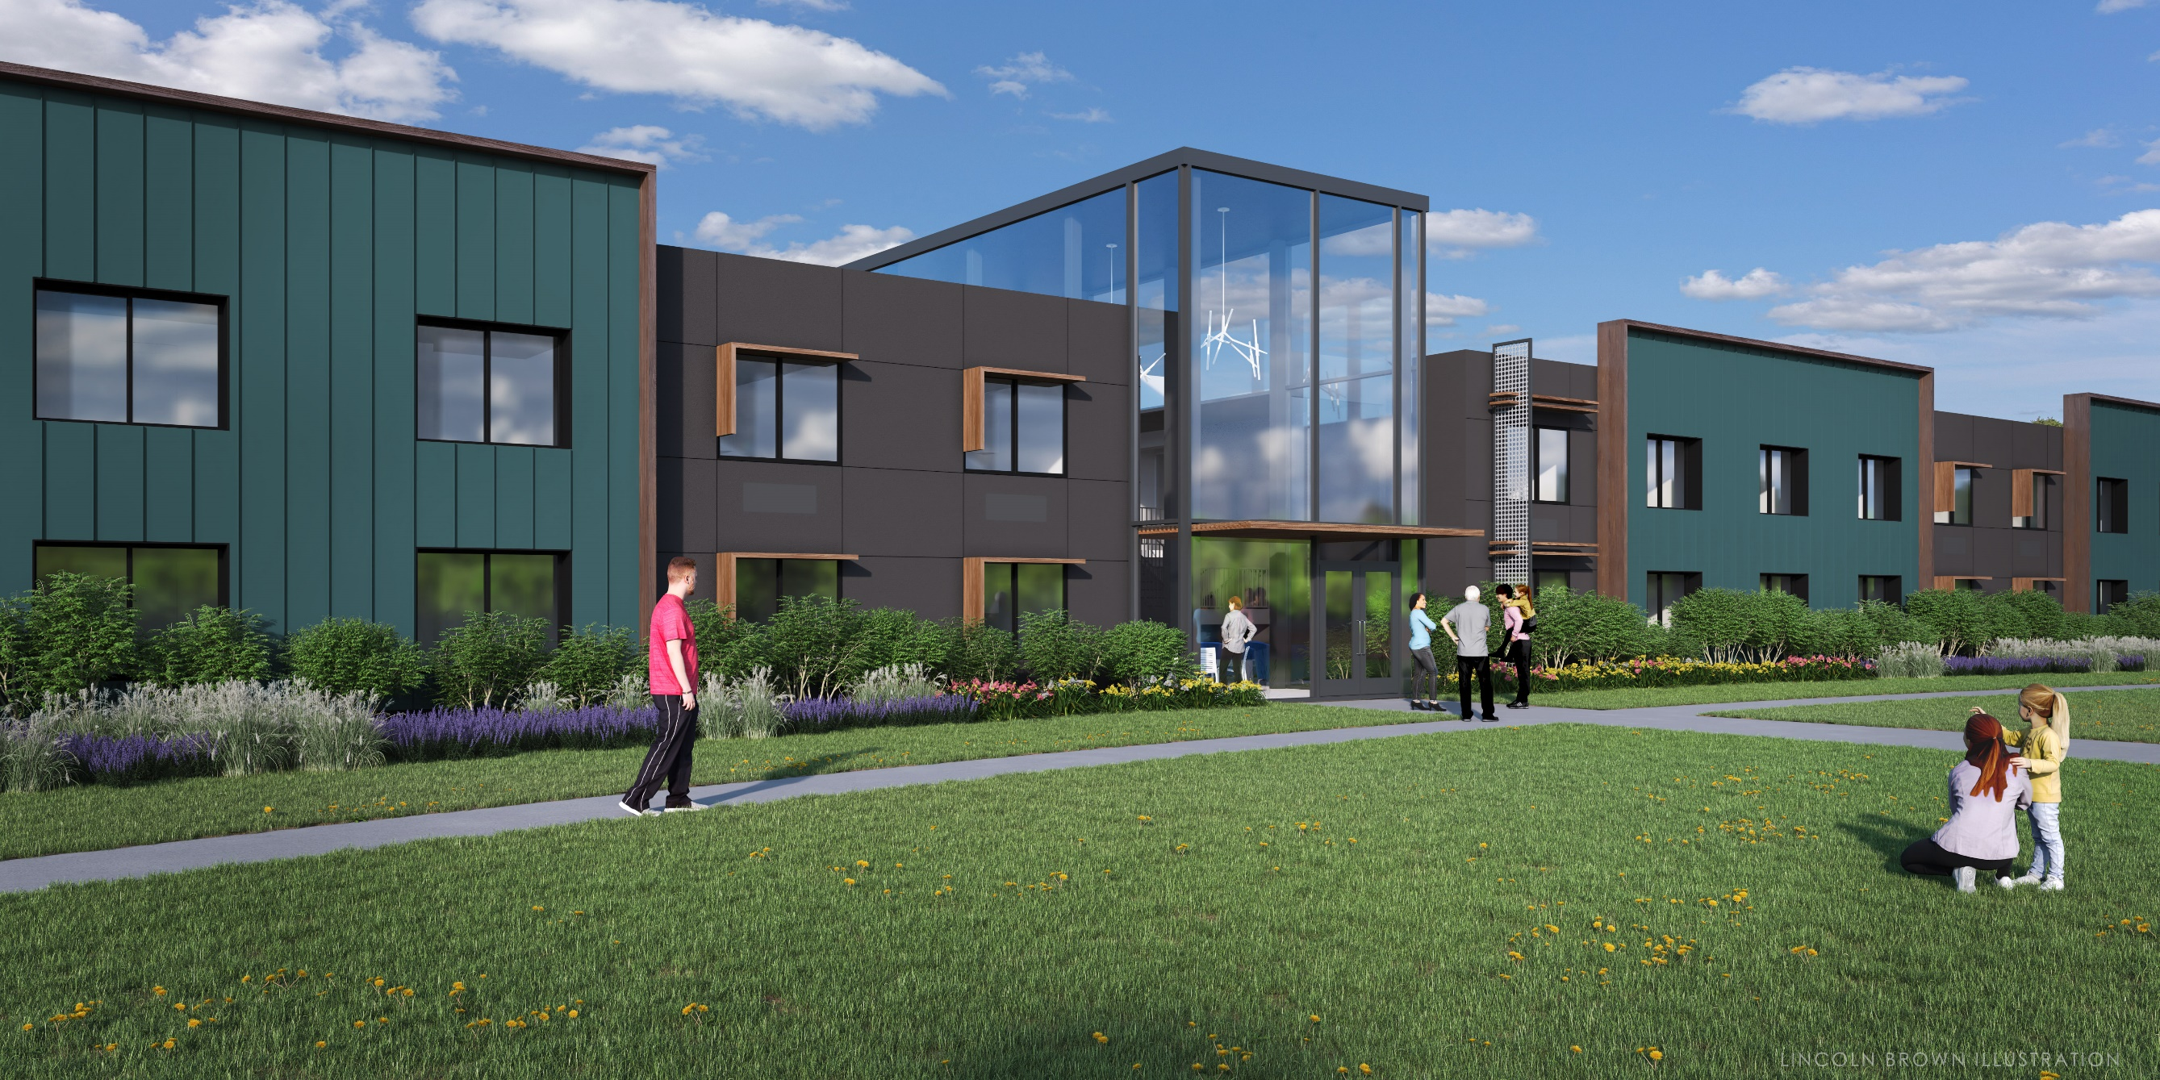
82 Permanent Supportive Housing Apartments.
ESSHI Populations
(30) Chronically Homeless
(18) Serious Mental Illness
(18) Substance Use Disorder
(8) Young Adult
(4) HIV/AIDS
(2) Domestic Violence
(2) Veterans

Slide 10
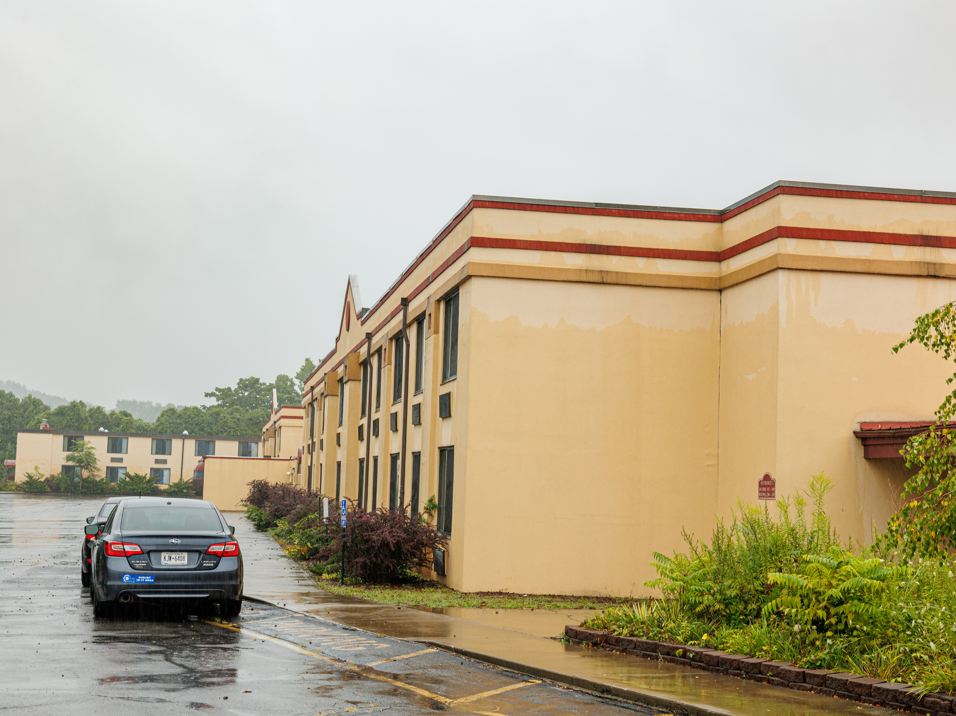
Total Development Cost: $47,308,074
Sources:
FHLBNY
HHAP
HONDA
CIF
CEI
Novo Foundation
Ulster County

Slide 11
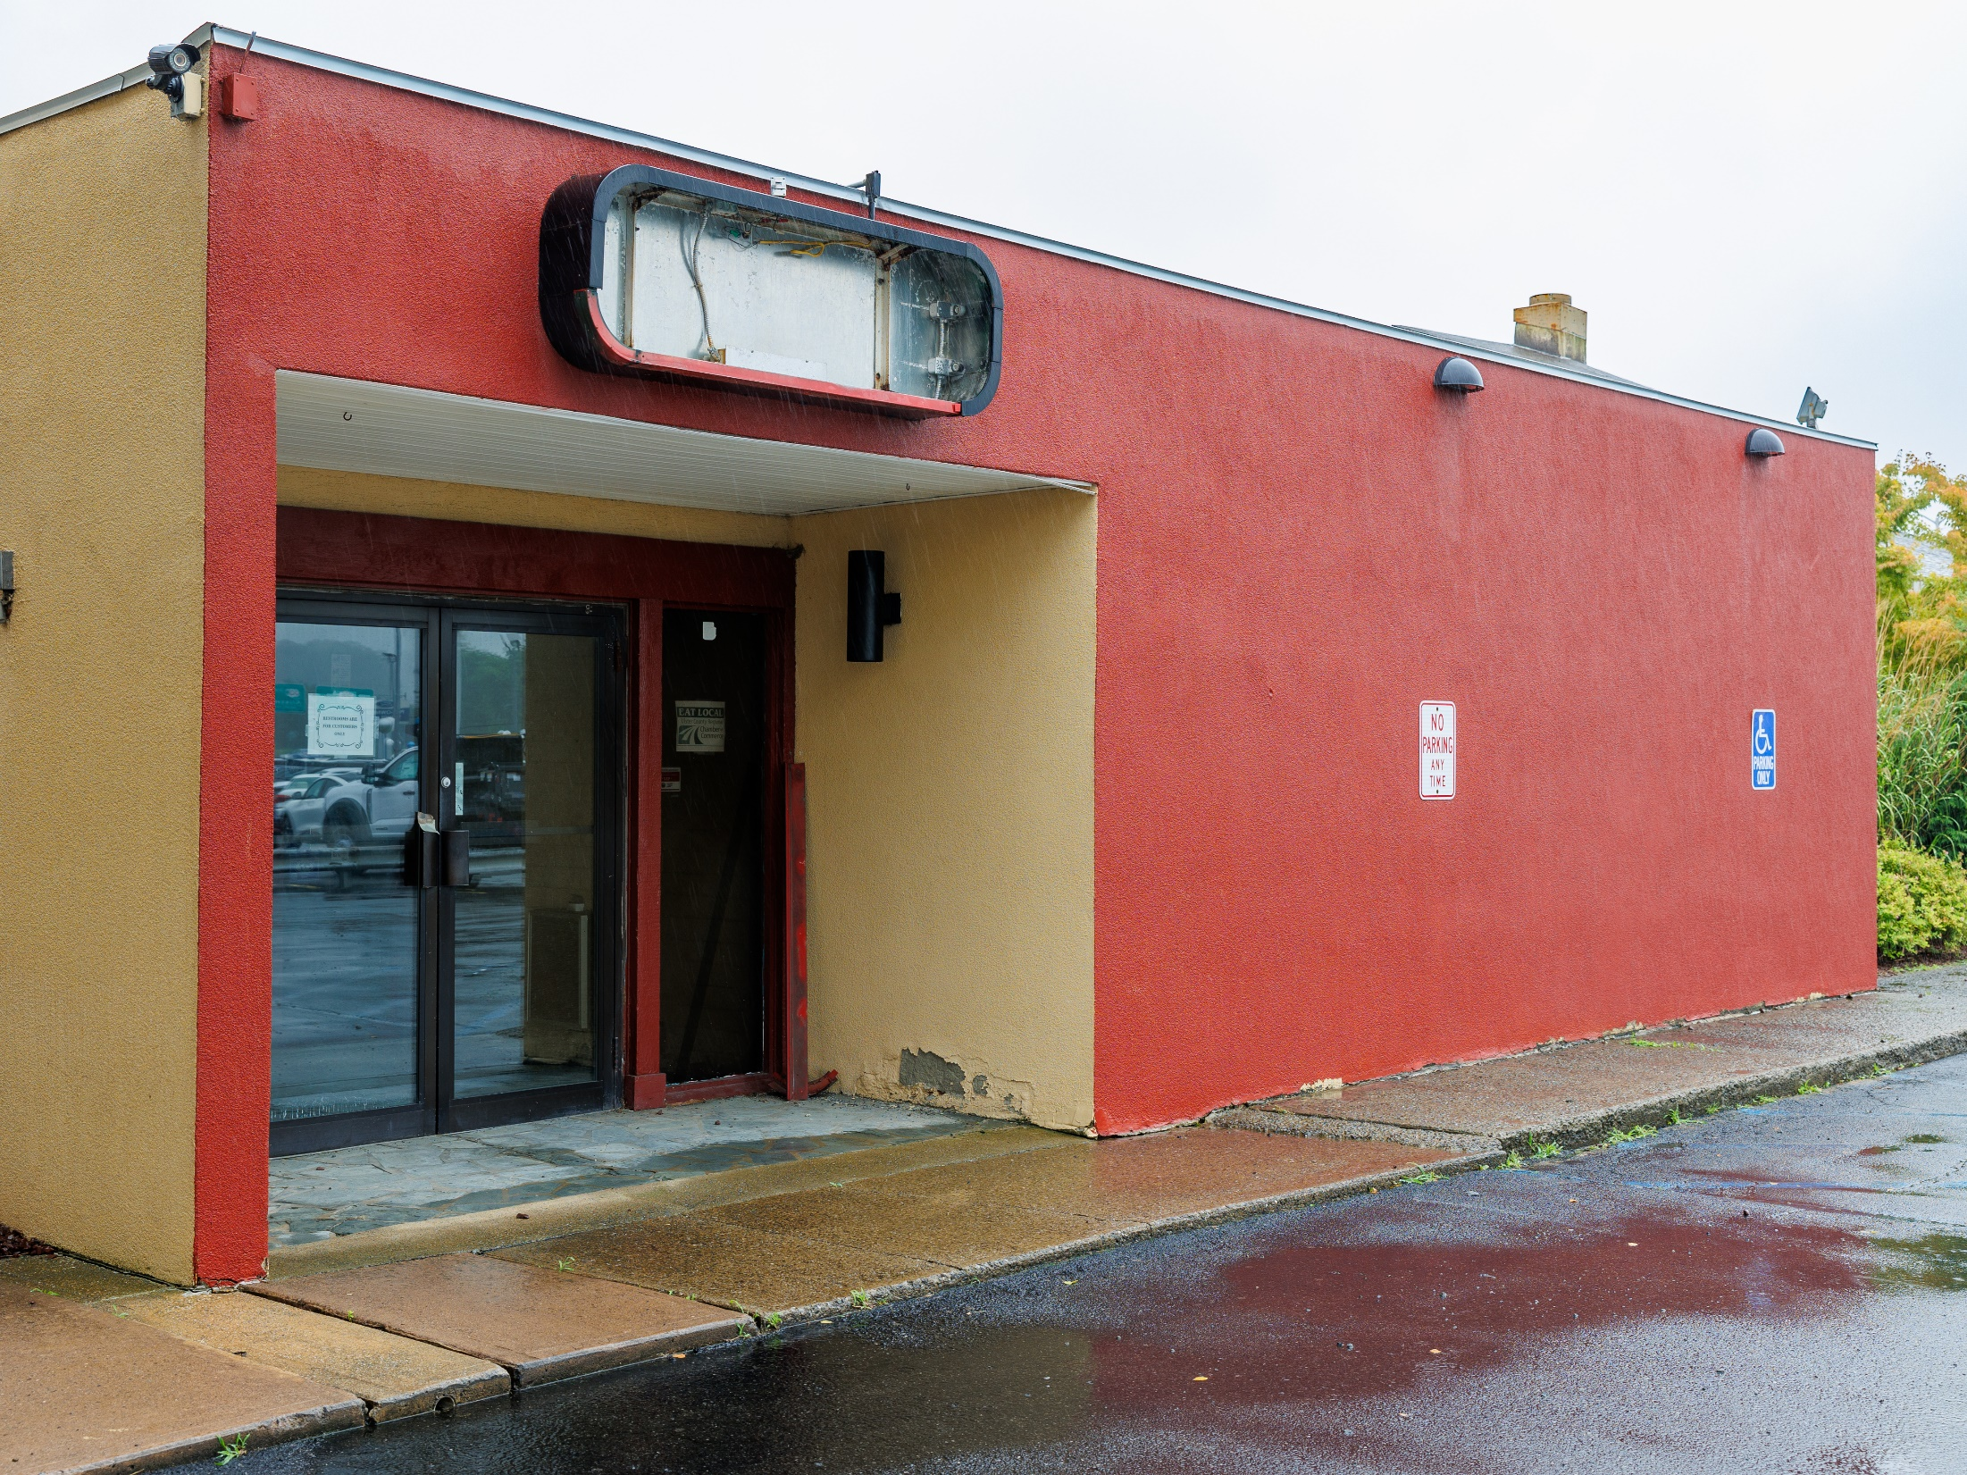
COMMERCIAL SPACE
Approx 9,000 sq. ft of leasable commercial space in former Roudigan's steakhouse.
Future YWCA daycare facility.
Commissary kitchen.
Salt water therapeutic pool.

Slide 12

Rebuilding homes, revitalizing communities, rebuilding lives.

Slide 13
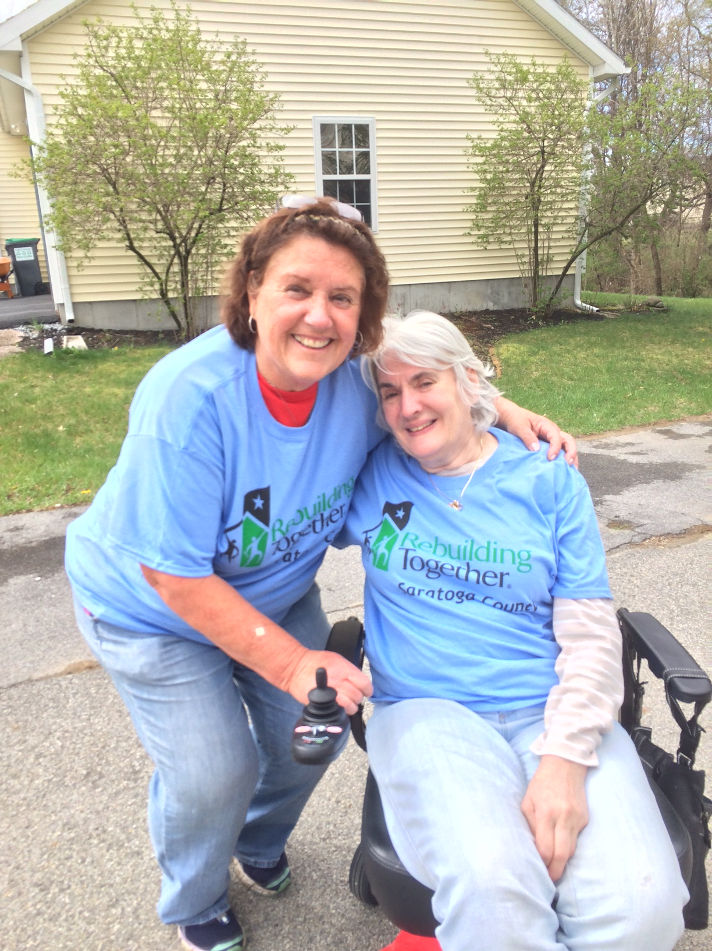
WHAT WE DO
Non-Profit serving low-income homeowners in Saratoga, Warren, and Washington Counties
Services and Programs
Critical home repairs and accessibility modifications
Mobile home replacement
Health and safety visits
Handyman repairs

Slide 14
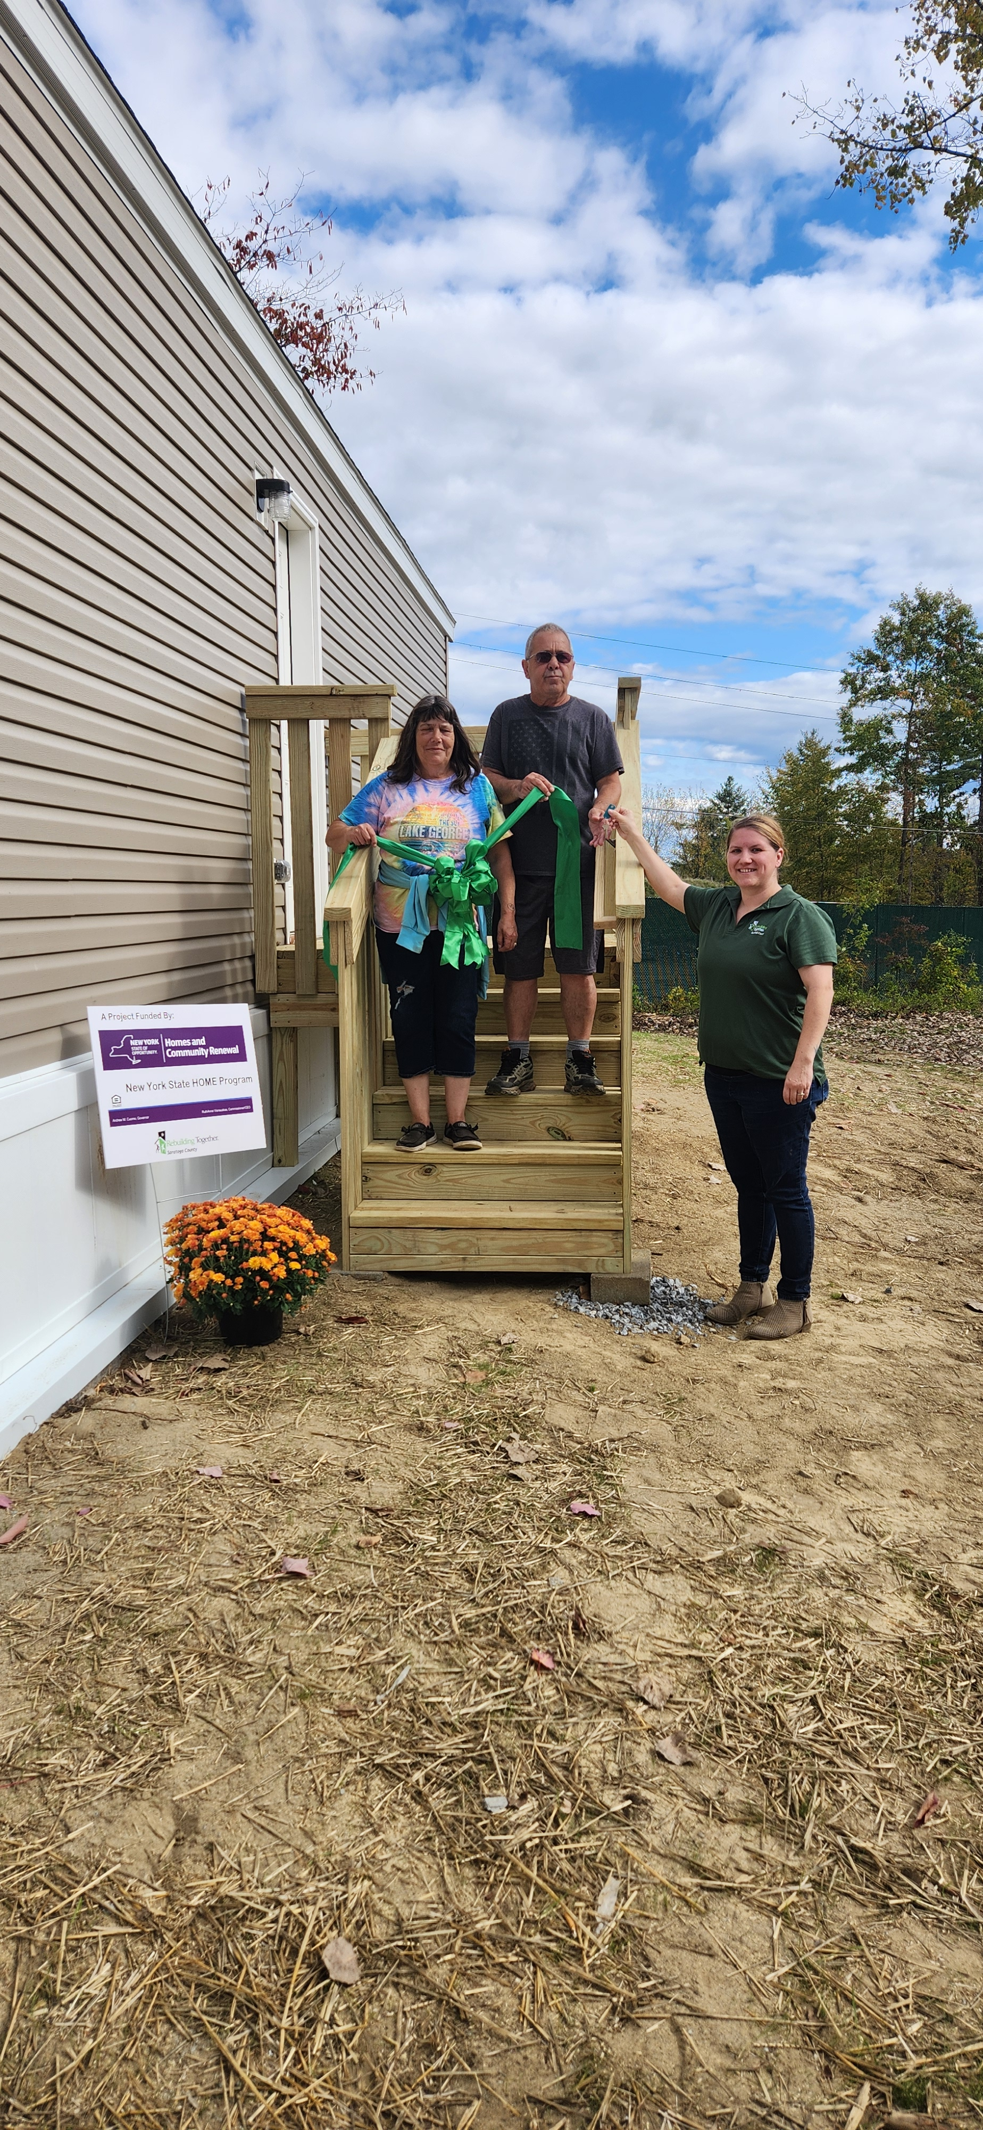
MOBILE HOME REPLACEMENT
Replace substandard manufactured homes
Started the program in 2017
96 homes replaced to date
17 homes are in progress
Funding Sources
NYS Mobile and Manufactured Home Replacement
NYS HOME Manufactured Home Replacement
FHLBNY Affordable Housing Program
NYS Affordable Housing Corporation

Slide 15
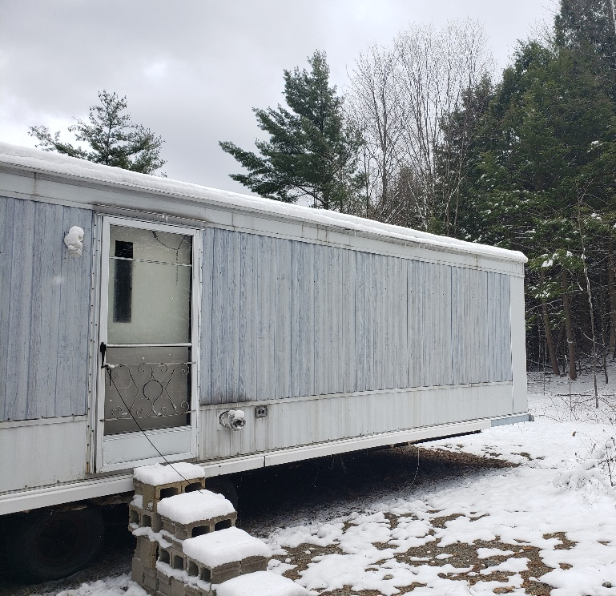
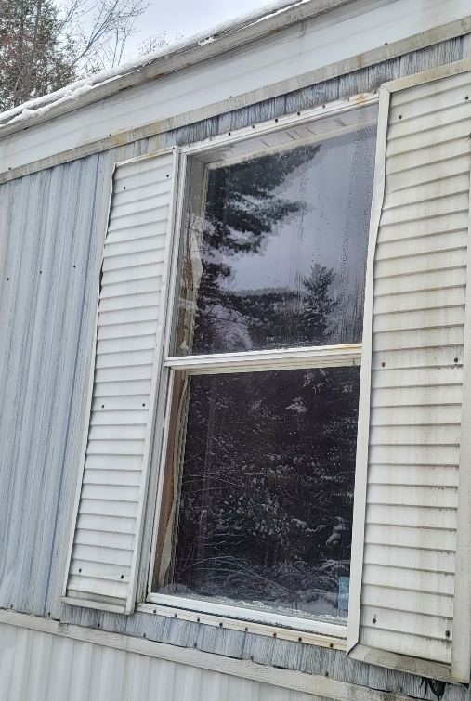
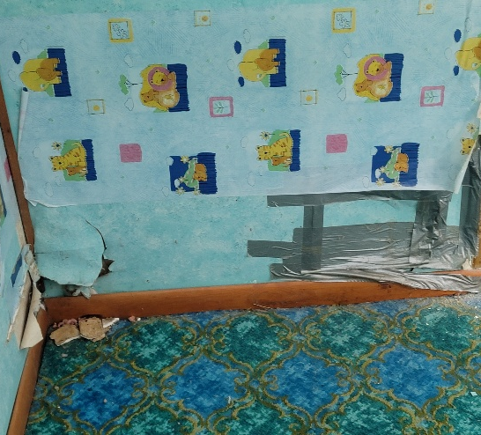
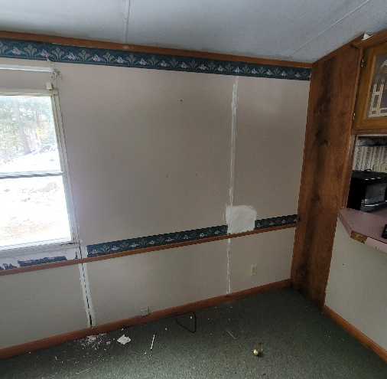
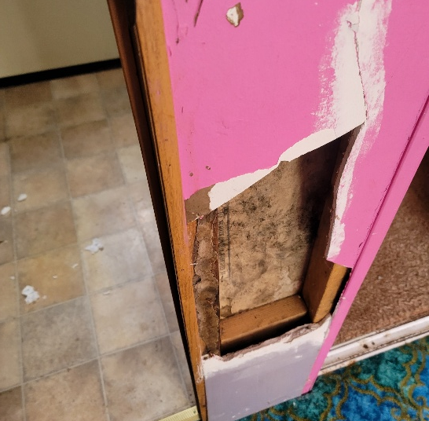
BEFORE

Slide 16
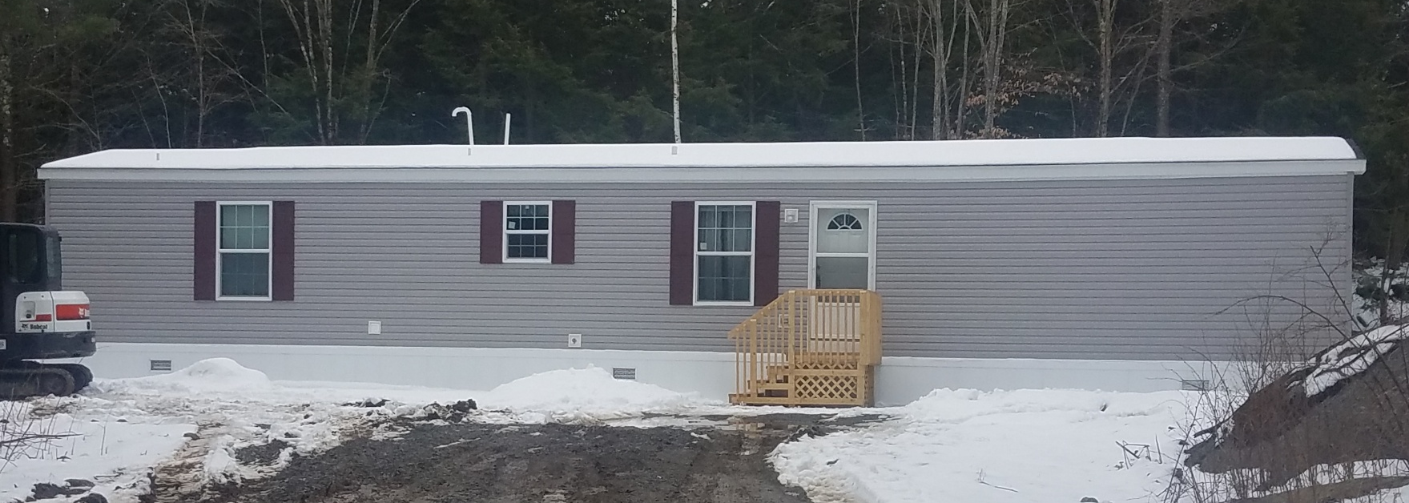
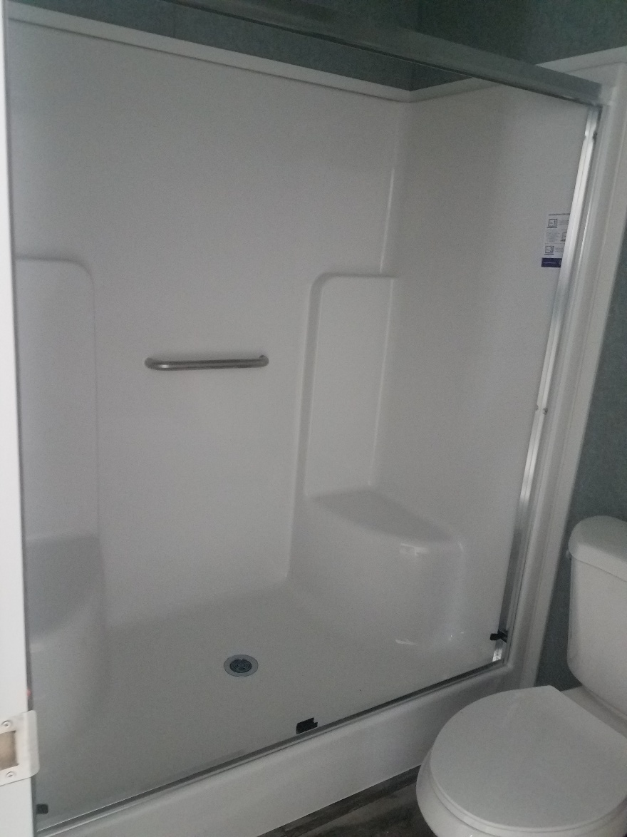
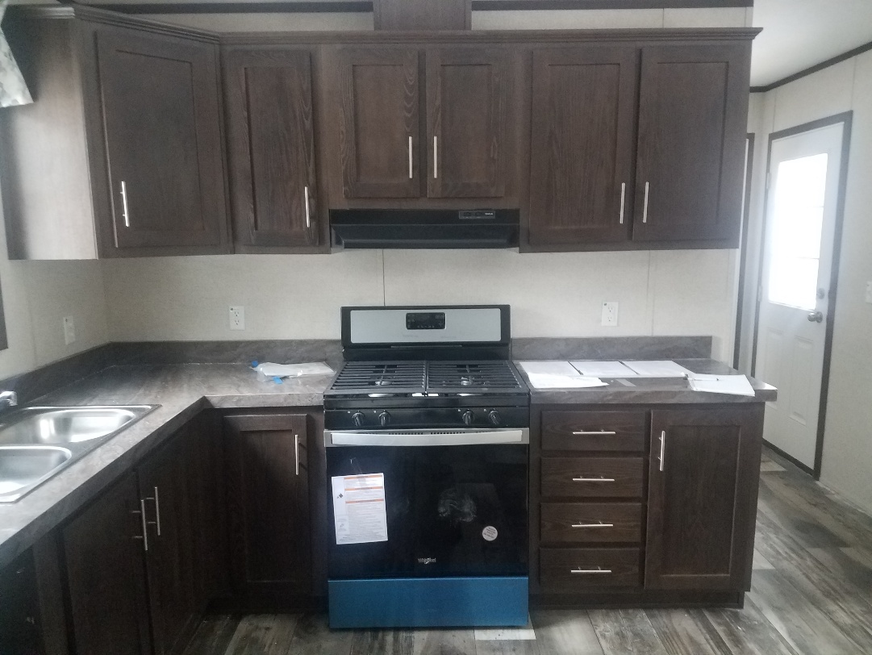
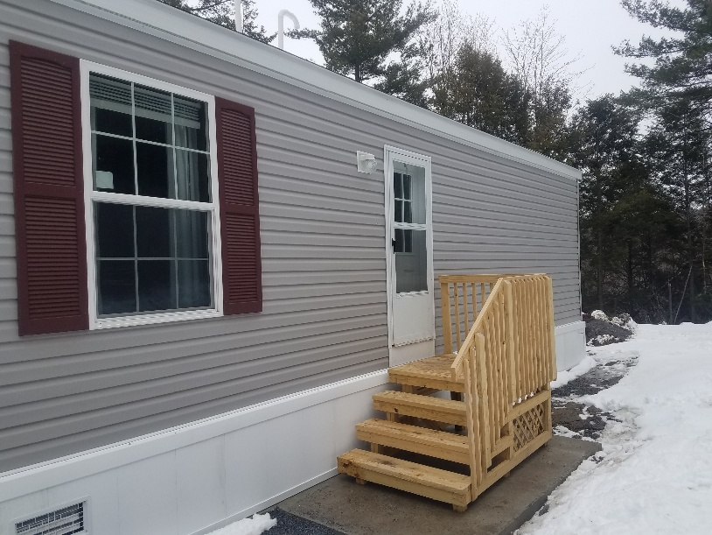
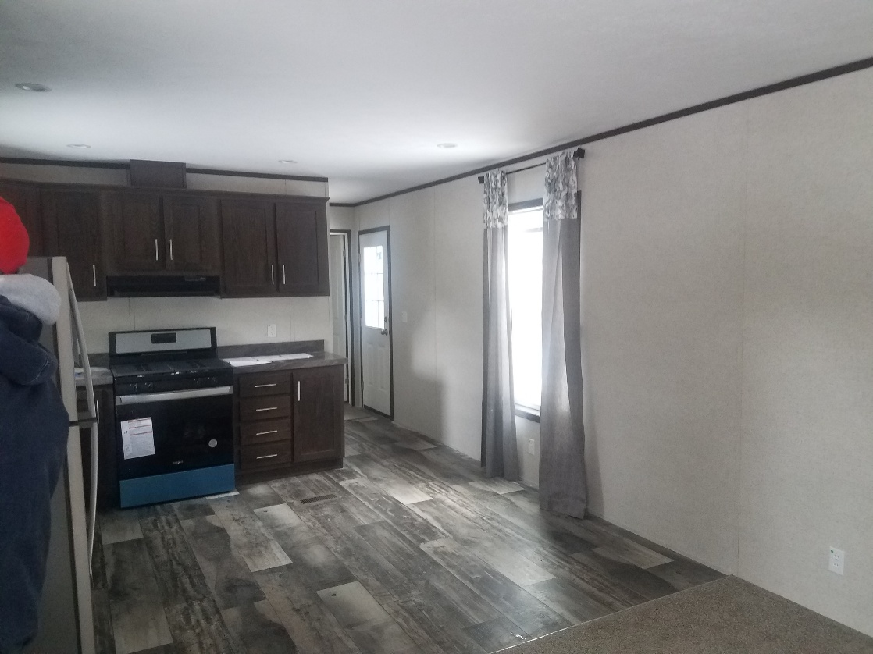
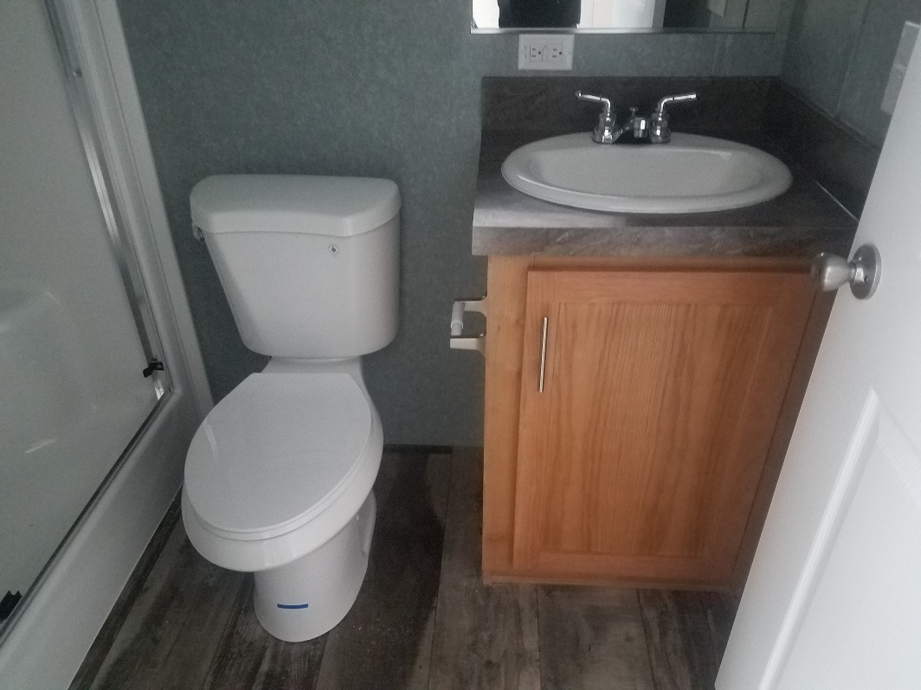
AFTER

Slide 17
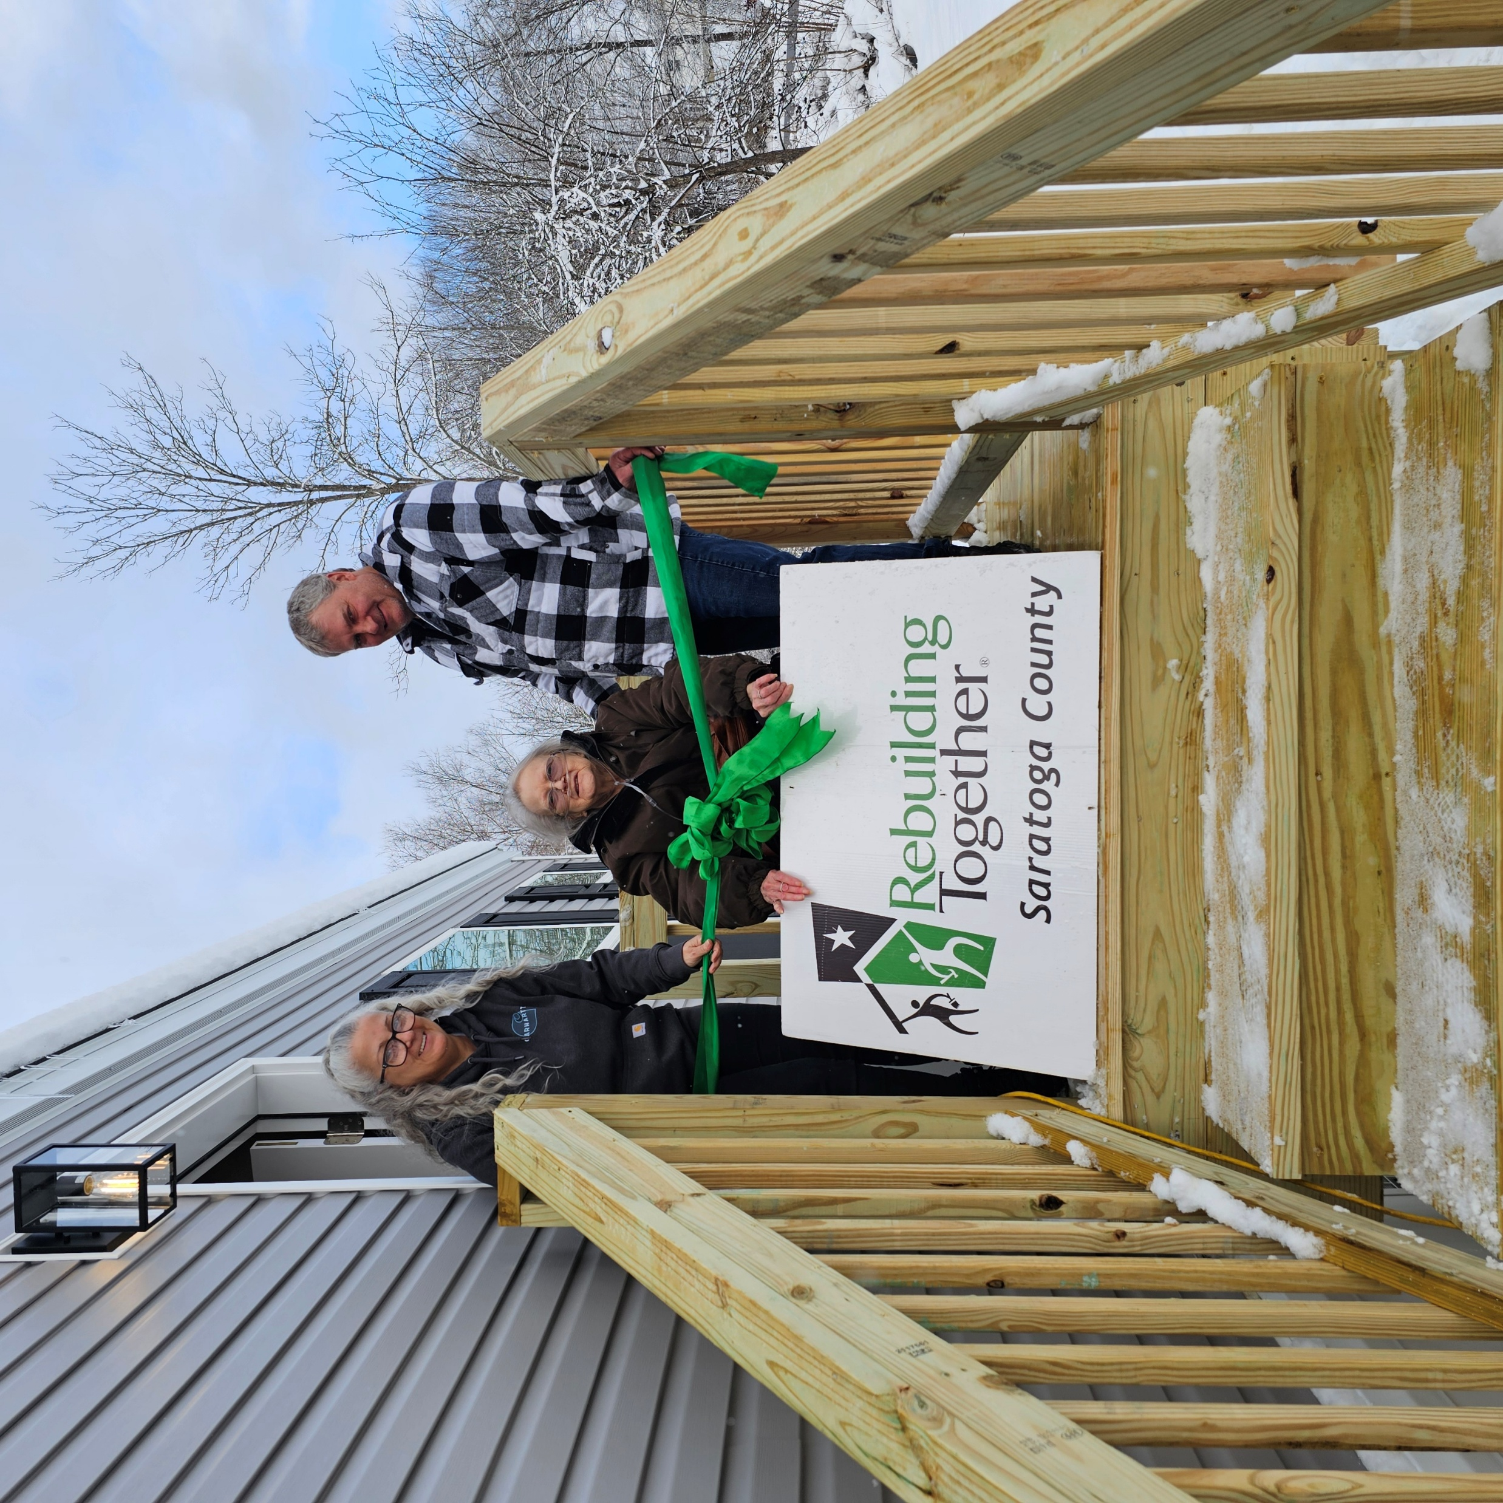
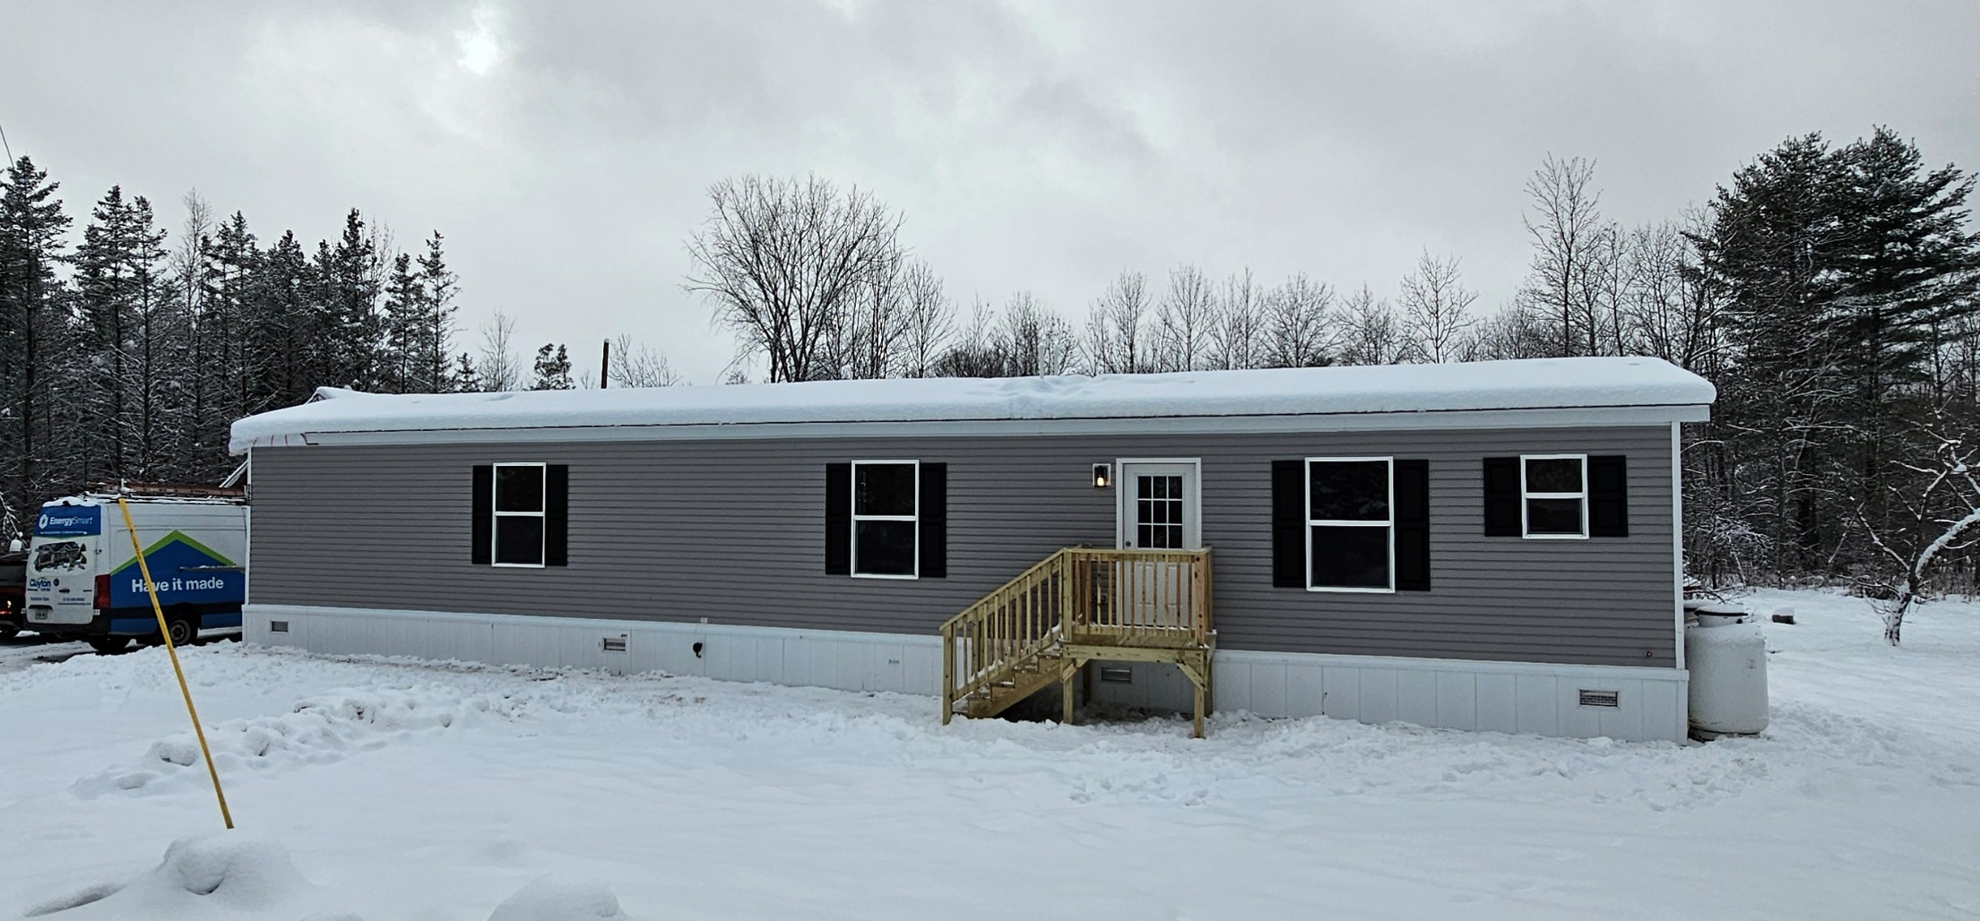
FEDERAL HOME LOAN BANK of NY Affordable Housing Program
Leveraging AHP funds to purchase the new unit
Upfront cost, one invoice

