Slide 1


Preserving Rural Housing
Robin Wolff, Senior Director, Rural Housing
Kendra Home, Senior Program Director
Notes:
Adrienne

Slide 2
Enterprise Community Partners
Mission and vision
OUR VISION​​ A country where home and community ​are steppingstones to more. ​​ ​​
OUR MISSION​​ To make home and community places of pride, power and belonging, and platforms for resilience and upward mobility for all. We focus on three pillars:
Increase Housing Supply
Advance Racial Equity
Build Resilience and Upward Mobility

Slide 3
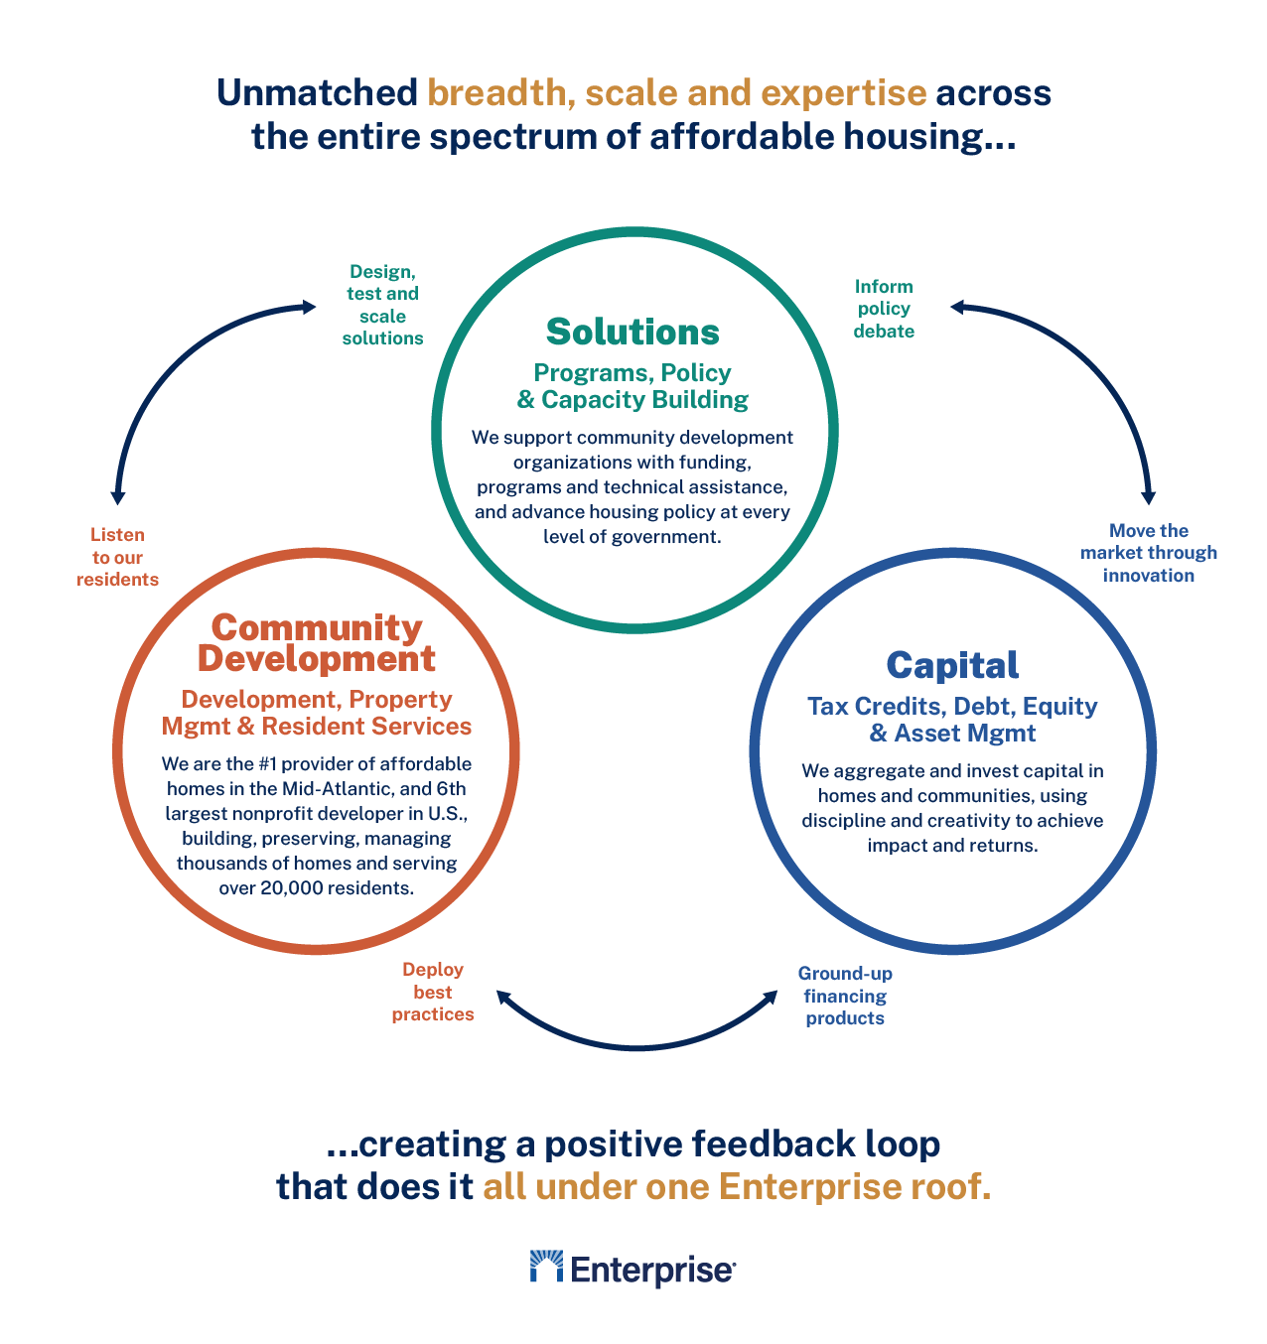

Slide 4
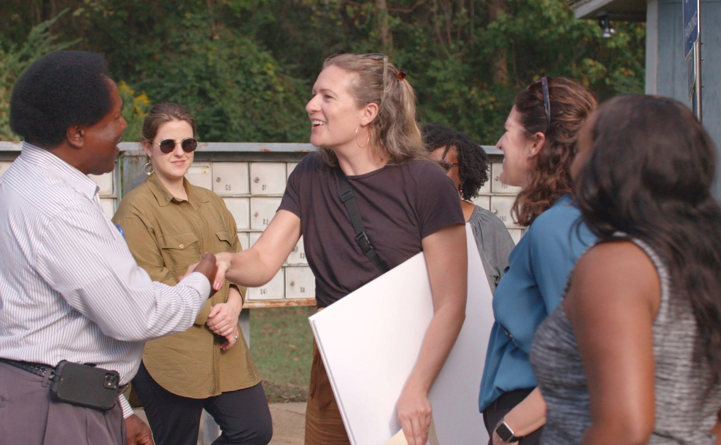
USDA 515 Technical Assistance
​
Enterprise has contracts to that enable us to provide nonprofit organizations and housing authorities across the country with technical assistance and training to preserve USDA 515 properties.
We are currently providing targeted technical assistance to over 30 organizations as they work to preserve subsidized housing stock in their communities. This TA will support the preservation of over 750 units.
In response to market demand, we are working to expand our TA to other affordable housing developers employing a fee-for-service model.
Notes:
Sample slide

Slide 5
Stages of USDA Transfer Application Process
There are four stages to the approval process to know
Stage 0 – Prepare
Unofficial, critical stage
Concept call with USDA
Request MFIS Reports
Order appraisal
Order C.N.A.’s
Review 504 Plan; review and ensure current
Plan SOW; start plans and specs
Cost Estimate; involve GC
Stage 1 – Processing
Initial Application Submission
All items to 7-B-1 submitted via CloudVault simultaneously.
Review will not begin until all items have been received.
Additionally, approved items are needed before Stage 2 – UW
Appraisal
C.N.A (As-Is and Post)
Must submit SOW, Plans, Specs, AIA Contracts (drafts), & mgmt. documents for review.
Stage 2 - Underwriting
Underwriting review of Preliminary Assessment Tool (PAT)
Final review of the following:
Operating expenses
Rent levels
Reserve requirements
Tenant Protection Account
Insurance
Cost estimate
Third party financing terms
Third party loan documents
Total Development Costs
Narratives
Letter of Conditions
Stage 3 – Closing/OGC
Closer will be assigned and work with OGC to close.
Closer will prepare closing package for OGC review.
OGC will review:
Organizational documents
Third party loan documents
Intercreditor Agreements
Subordination Agreements
Attorney Opinions
Upon approval OGC will issue the Closing Instruction and provide Agency Loan documents to close.

Slide 6
Rural Rental Housing Preservation Academy and TA
Supporting projects to problem solve and get through the process
Overview and Introduction to Rural Rental Housing Preservation
Introduction to Rural Development 515 Transfer Process
Strategies for 515 Preservation: Case Studies
Capital Needs Assessment and Operating Budget
Basic Deal Structuring
Understanding Tax Implications of a Transfer
Pro forma development
National Policy Conversation-521 Rental Assistance and Decoupling
Funding Beyond RD: LIHTC, Bonds and Third-Party Lenders/ Connecting Buyers and Sellers
Property Management/Community Engagement–2 sessions, including
Property Stewardship: Resident Services and Asset Management

Slide 7
Richland Gardens

Slide 8
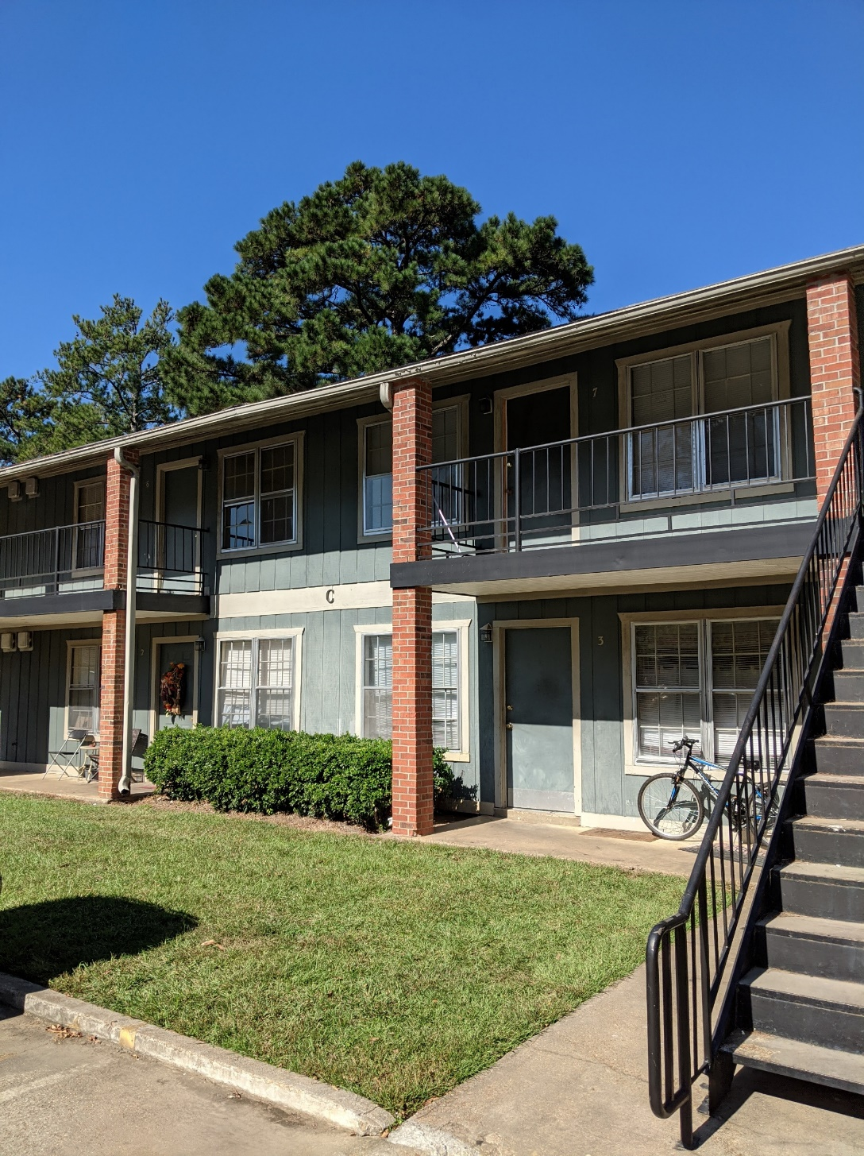
54 units (48 rehab, 6 new construction)
Located in Richland, MS
Development/Ownership Partners:
Gulf Coast Housing Partnership
Trinity Development
LIHTC award 2019
515/538 application 2021
Closing January 2023

Slide 9
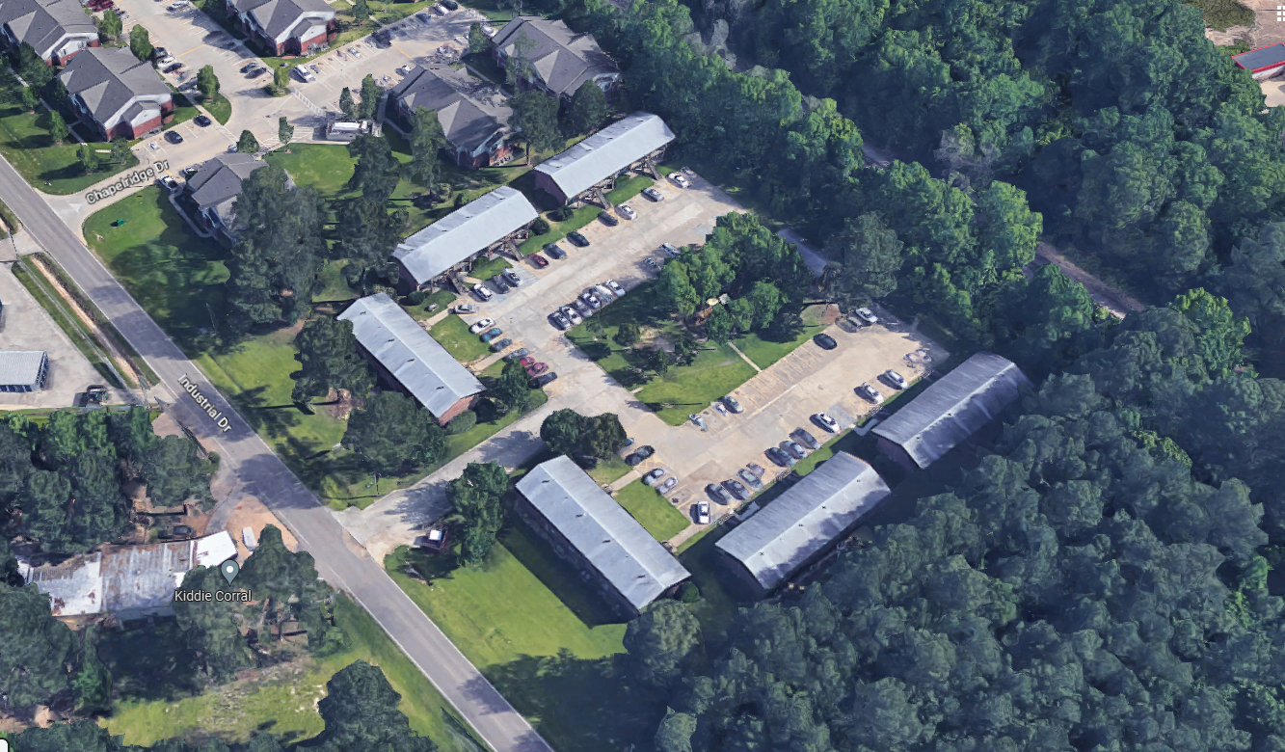
Richland Gardens
Built 1982, partially rehabbed in 1995 after original LIHTC award
Notes:
PRESERVATION OF AGING HOUSING
GCHP is partnering with the current owner/manager of the property to develop
515 loan 1993 and LIHTC award 1993
Art Cook architect and LCS Inc is the general contractor
Notice the treeline to the right of the property

Slide 10
Sources & Uses
Richland Gardens
Richland Gardens, LP
Closing: January 19, 2023
Sources |  |  | Funder
Construction Period
Construction Loan | $ 6,197,000 |  | Regions Bank
OZ Investment | $ 525,000 |  | HOPE Credit Union
Permanent
RD 538 Perm Loan | $ 1,916,000 |  | Churchill Stateside Group
RD 515 Perm Loan | $ 1,024,743 |  | USDA Rural Development
RD 515 Perm Loan - Subsequent | $ 512,252 |  | USDA Rural Development
9% Tax Credit Equity | $ 8,387,576 |  | Regions Bank
AHP Atlanta | $ 479,307 |  | FHLB Atlanta
GP Capital Contribution | $ 110
Total | $ 12,319,988

Slide 11
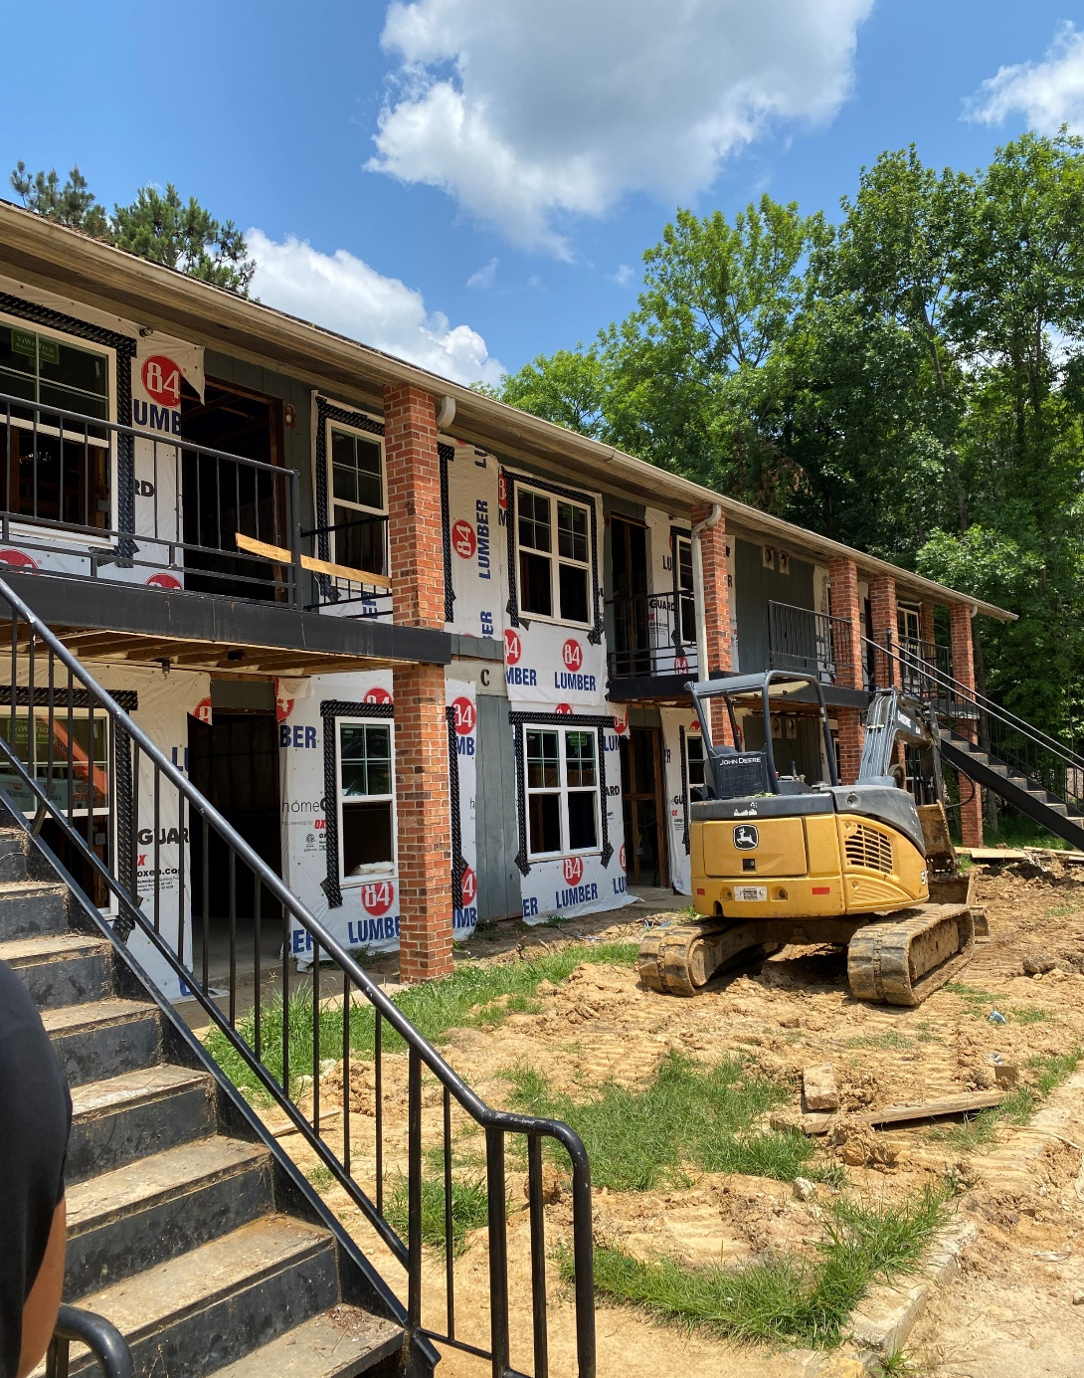
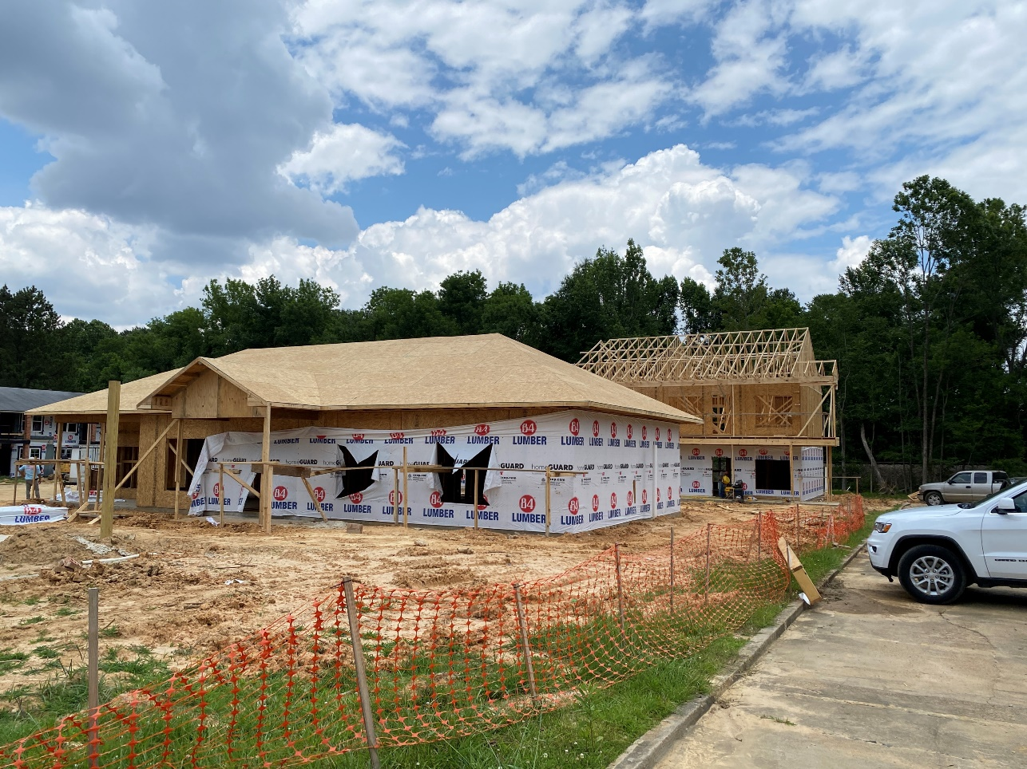
June 2023
Richland Gardens
Notes:
Progress!

Slide 12
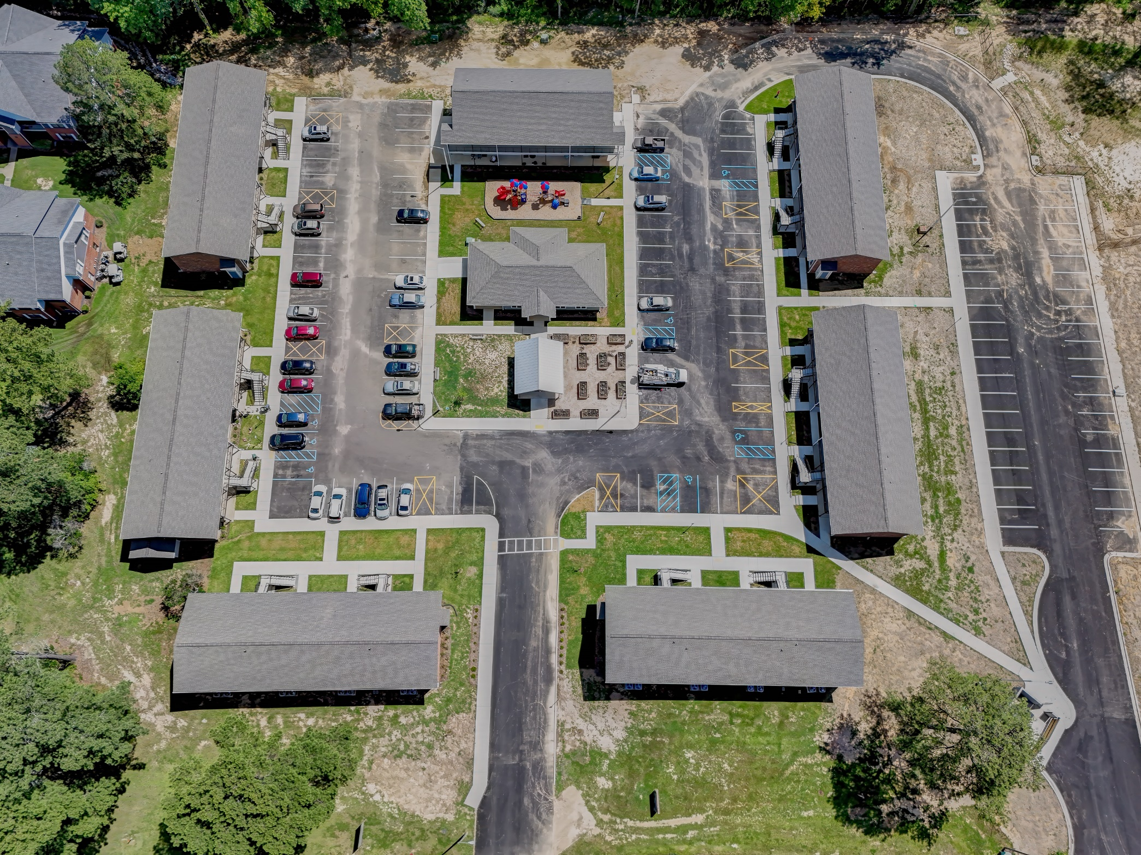
July 2024
Richland Gardens
Notes:
Progress!

Slide 13
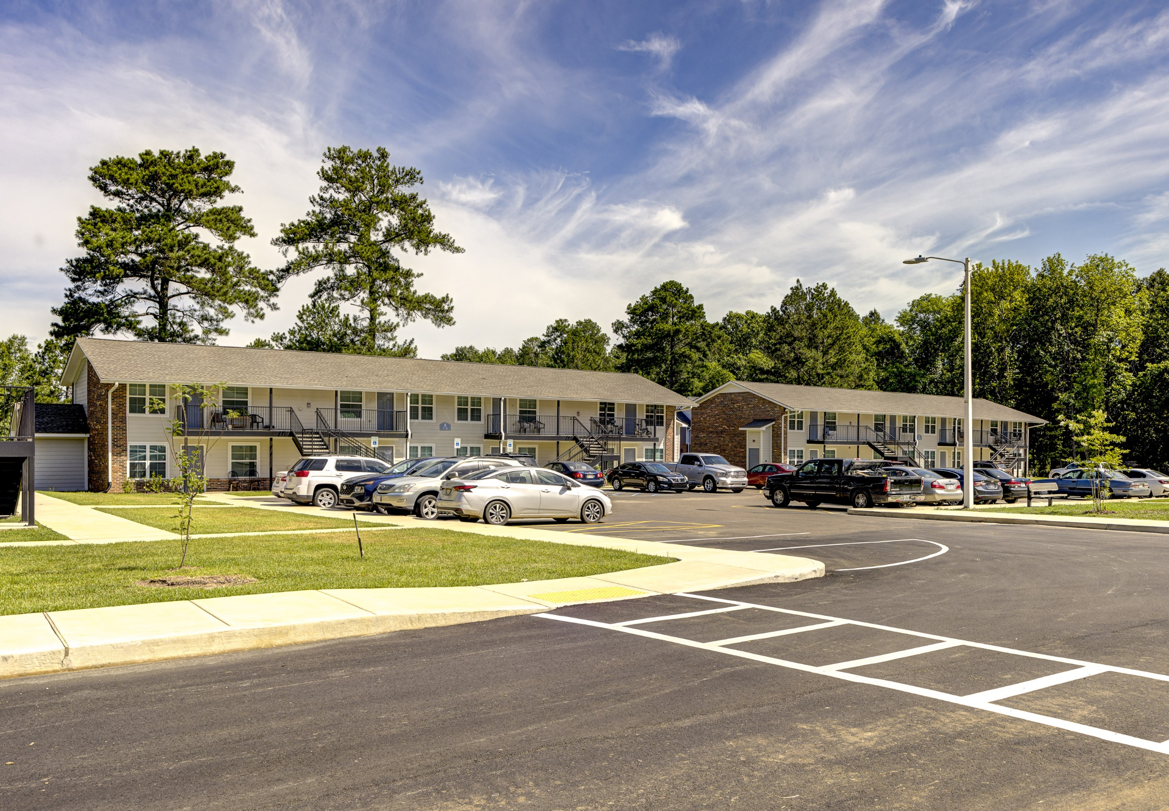
July 2024
Richland Gardens
Notes:
Progress!

Slide 14
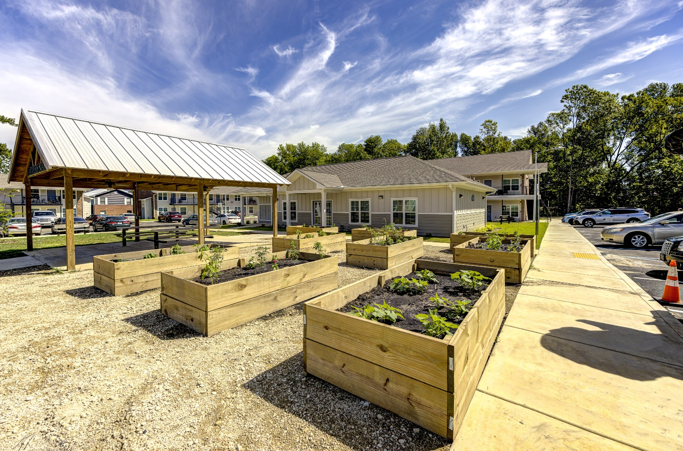
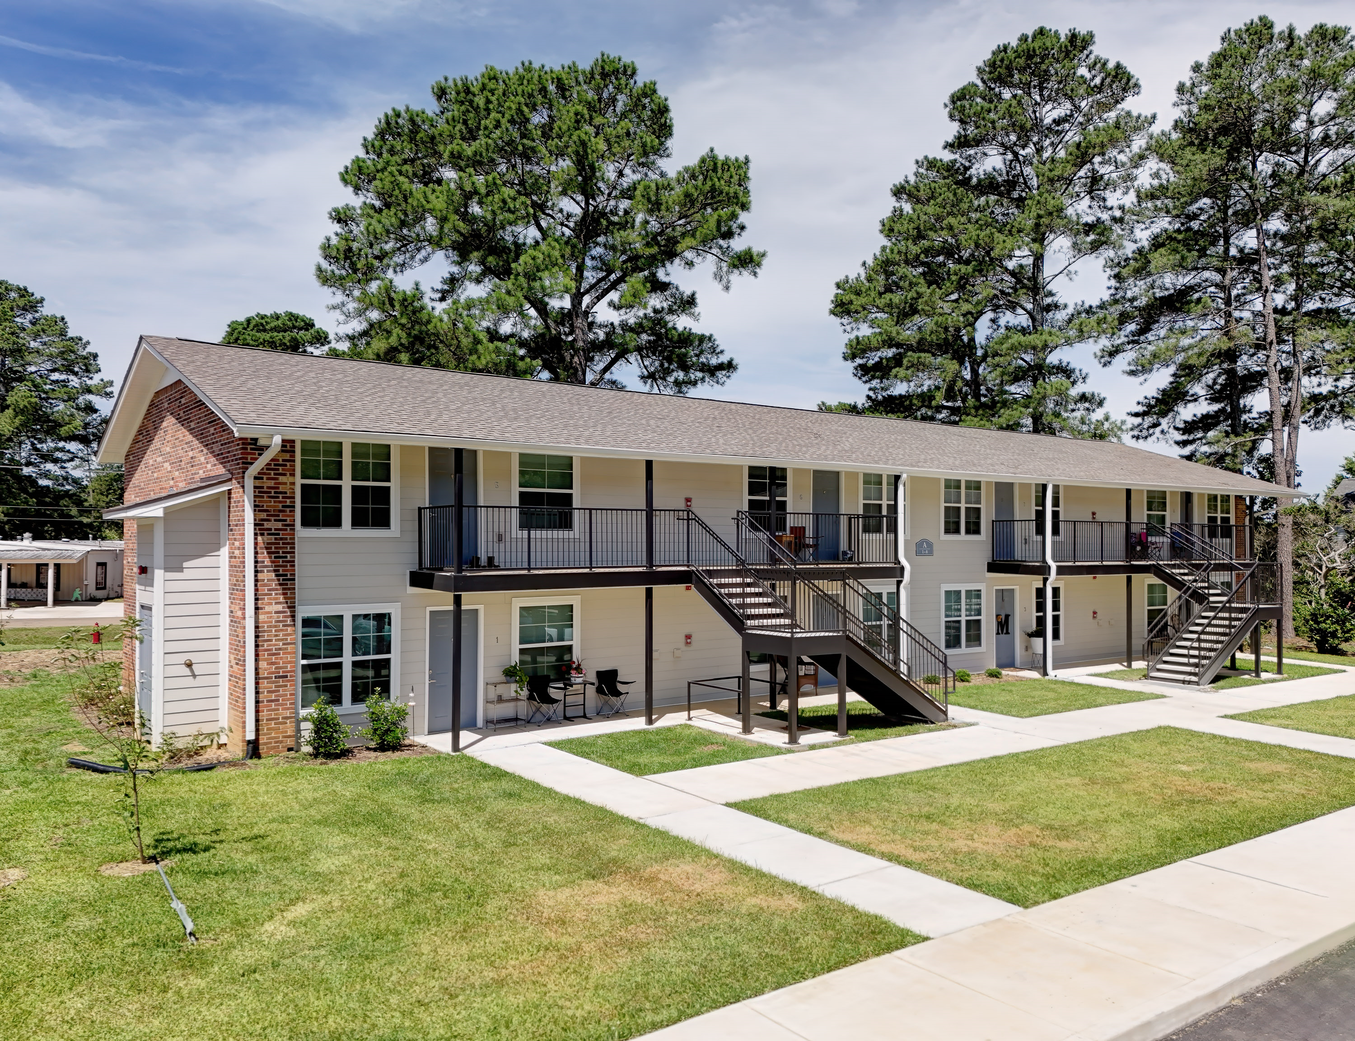
July 2024
Richland Gardens
Notes:
Progress!

Slide 15
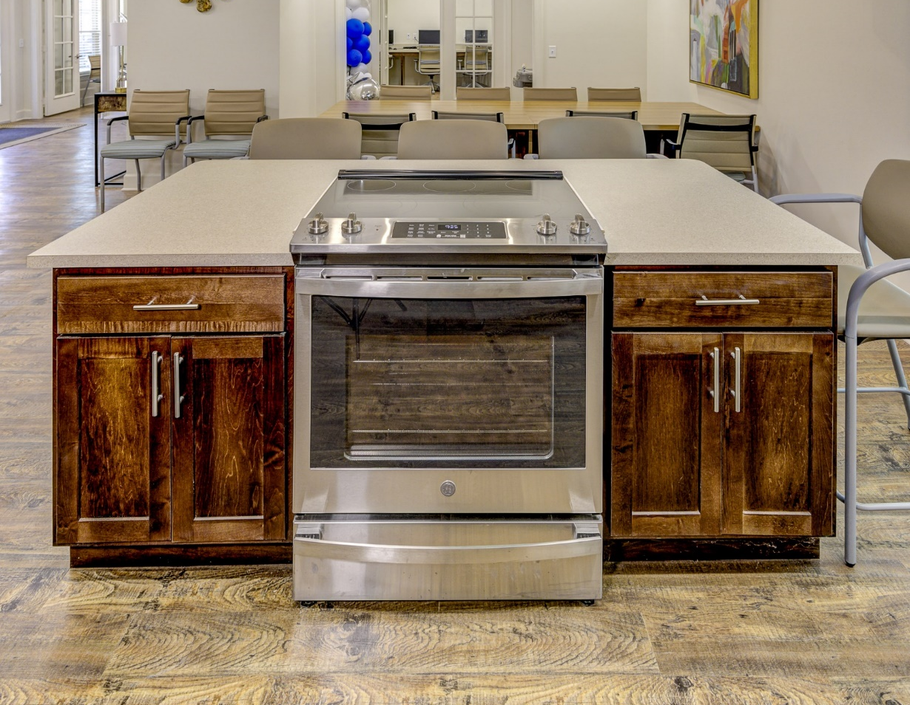

July 2024
Richland Gardens
Notes:
Progress!

Slide 16
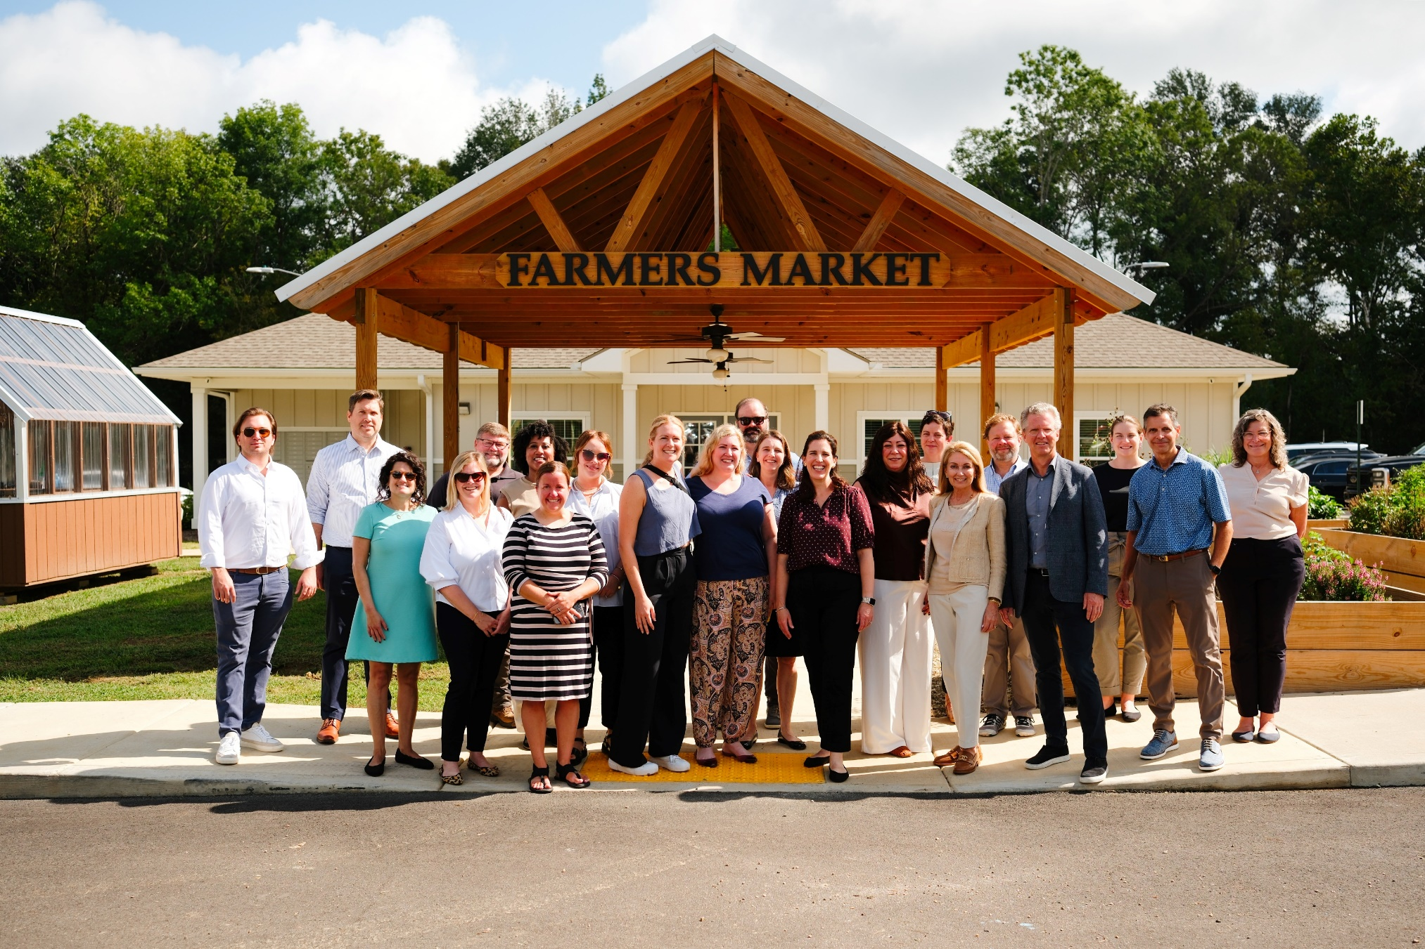
September 2024
Richland Gardens
Notes:
Progress!

Slide 17

Robin Wolff
robinwolff@enterprisecommunity.org
Kendra Home
khome@enterprisecommunity.org
Thank You

