Slide 1
Private & Corporate Grants
Researching opportunities, writing proposals
and cultivating funder relationships
Cherisse Young
Director of Foundation and Corporate Grants, Siena University
Rural Housing Coalition Annual Conference • 2026
Siena University
01
Notes:
Welcome attendees. Suggested session length: 60 minutes, including two short exercises and discussion. Introduce yourself as Cherisse Young, Director of Alumni Engagement at Siena University. Draw on your foundation and corporate grant work only through examples you can personally verify. Do not imply that Siena funds rural housing organizations. Conference source: https://ruralhousing.org/annual-conference-2026/

Slide 2
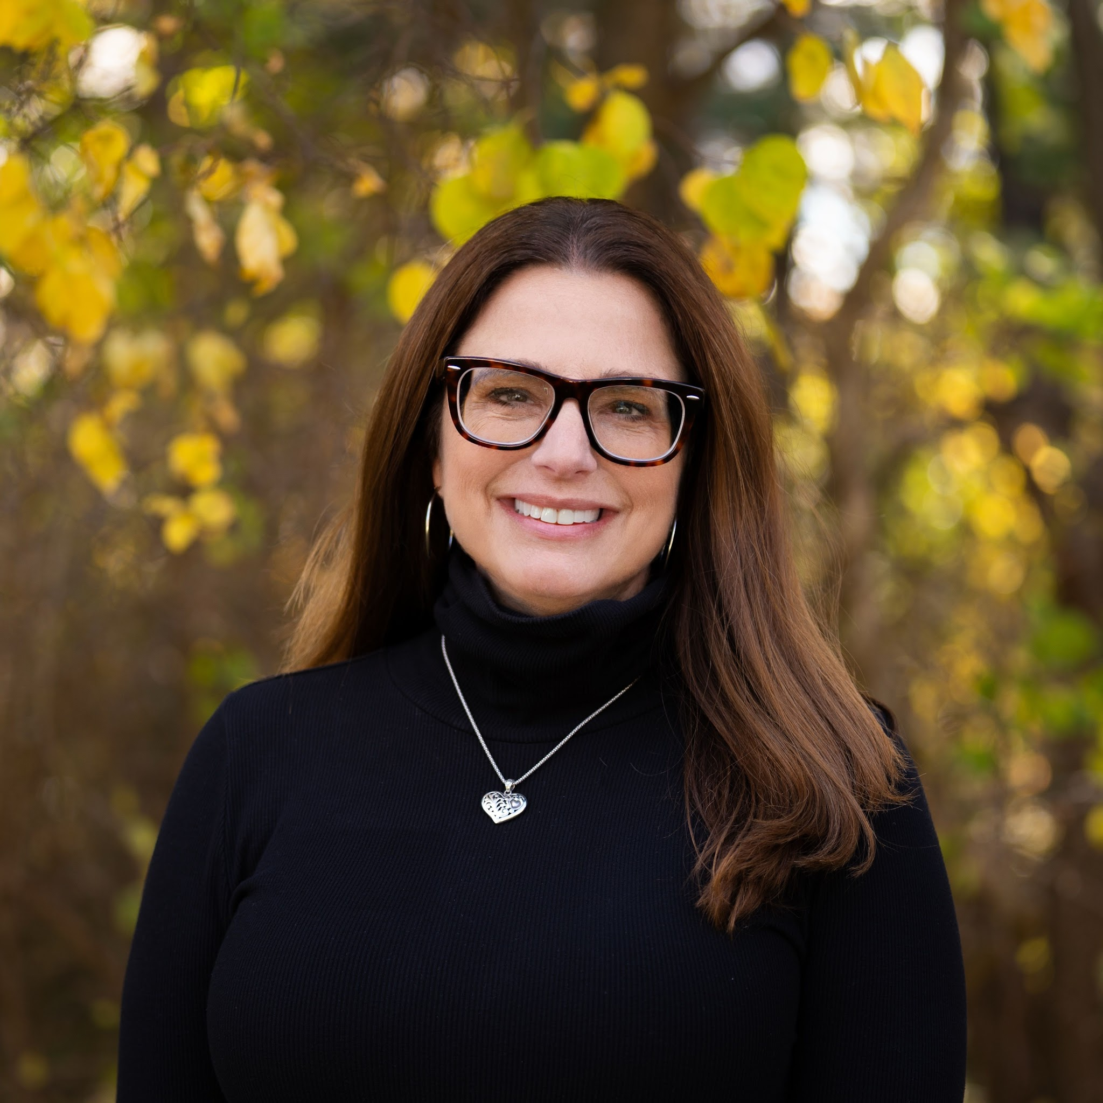
Cherisse Young, M.A.
Director of Foundation of Corporate Grants at Siena University
Executive Director of $10 million nonprofit human service organization for 15 years
Masters in Nonprofit Management
Siena University
02
Notes:
2 minutes. Ask for a show of hands: Who writes grants as one part of a larger job? Who has a dedicated grant staff member? Explain that the session focuses on a repeatable process for teams with limited time.

Slide 3
Today’s working questions
Which funders fit our organization and project?
What makes a proposal clear and credible?
How do we build relationships before and after an award?
Siena University
02
Notes:
2 minutes. Ask for a show of hands: Who writes grants as one part of a larger job? Who has a dedicated grant staff member? Explain that the session focuses on a repeatable process for teams with limited time.

Slide 4
Your next funding need
What would funding make possible
for your organization?
Write down the project, the people it serves and the amount you think it will require.
Siena University
03
Notes:
2 minutes. Invite attendees to choose one real need to carry through the session. Ask two attendees to share briefly. Examples include accessibility repairs, a housing counselor, resident services, or a better data system.

Slide 5
Private and corporate funding routes
Route | What to research | Possible request
Independent or family foundation | Mission, geography, past grants | Program, operations or capacity
Community foundation | County coverage and named funds | Local housing or community need
Corporate foundation | Giving priorities and service area | Eligible community program
Direct corporate support | Community giving or marketing contact | Grant, sponsorship or in-kind support
A grant and an event sponsorship may use different criteria and contacts.
Siena University
04
Notes:
3 minutes. Explain that a corporate foundation is also a private foundation structure. These are practical research routes rather than mutually exclusive legal categories. Each funder sets its own requirements. Direct corporate gifts can come through different departments.

Slide 6
A project brief before a prospect list
Fund the project/program
DO NOT build the program for the funding!
People and place: who benefits, and where?
Need and response: what evidence supports this approach?
Cost and delivery: what will it take, and who will do it?
Results: what change can we reasonably measure?
Siena University
05
Notes:
2 minutes. Recommend a one-page internal brief approved by program and finance staff. Include the full project cost, requested amount, timing, permissions, staffing and funding already secured. A new program should answer a real community need.

Slide 7


Siena University
03
Notes:
2 minutes. Invite attendees to choose one real need to carry through the session. Ask two attendees to share briefly. Examples include accessibility repairs, a housing counselor, resident services, or a better data system.

Slide 8
A practical prospect research sequence
1 Look at local nonprofits no matter what the mission
2 Review comparable nonprofits’ supporters and reports.
3 Search funder databases and corporate giving websites.
4 Verify each lead on the funder’s current website.
Siena University
07
Notes:
3 minutes. Search terms might include housing rehabilitation, accessibility, aging, community development, rural poverty and a county name. Look at supporters of peer organizations, but recognize that past support does not prove current eligibility. Record the date you checked the guidelines. Research source: https://candid.org/candid-search/find-nonprofit-funding/

Slide 9
Research tools and what they answer
Discovery
Verification
Candid search: funders and past giving
Candid partner locations: free local access
Peer annual reports: possible supporters
Funder website: current rules and process
IRS search: returns and exempt status
Program contact
Siena University
08
Notes:
2 minutes. Candid search combines Foundation Directory and GuideStar data. The website lists free partner access locations. Access and product features may vary, so confirm locally. IRS Tax Exempt Organization Search provides public filings and status information. Tax returns describe a prior period and may lag. Sources checked September 30, 2026: https://candid.org/candid-search/find-nonprofit-funding/
https://candid.org/resources/candid-near-you/
https://www.irs.gov/charities-non-profits/tax-exempt-organization-search

Slide 10
What past grants can tell you
Repeated grantees suggest established relationships.
Comparable awards help you choose a realistic request.
Grantee locations help test geographic fit.
Grant descriptions reveal support types and priorities.
Past giving is evidence to investigate, not a promise of future funding.
Siena University
09
Notes:
2 minutes. Review multiple years where available. For private foundations, examine the grants-paid schedule and application information in the 990-PF. Use section headings because numbering can differ across form years. Distinguish paid amounts from multi-year commitments. Do not infer willingness to accept unsolicited proposals from a filing alone. Sources: https://candid.org/candid-search/find-nonprofit-funding/
https://www.irs.gov/charities-non-profits/tax-exempt-organization-search

Slide 11
A go / hold / pass decision
GO: eligibility, geography and purpose align.
HOLD: a specific unanswered question could change fit.
PASS: a clear exclusion or unworkable requirement applies.
Also assess award size, timing and staff capacity.
Siena University
10
Notes:
2 minutes. Mandatory eligibility criteria come first. An excellent relationship cannot fix an ineligible project. Consider the full cost of preparation, reporting, matching funds and delivery. A hold needs an owner and next action, not an indefinite place on the list.

Slide 12
Two real prospects, two different fit tests
Prospect | Verified program facts | Research implication
M&T Charitable Foundation | Public charity eligibility and M&T service area | Confirm local coverage and program fit
Home Depot Veteran Housing Grants | Veteran permanent supportive housing construction or rehabilitation | Check housing model and development requirements
Research examples only. Recheck guidelines and deadlines before pursuing either funder.
Siena University
11
Notes:
3 minutes. M&T supports eligible nonprofit programs in communities where the bank conducts business and separates grant support from marketing sponsorships. Its website currently lists an October 30, 2026 application close and asks for at least eight weeks before a decision is needed. Home Depot considers rural areas but gives priority to large cities. Its program covers hard construction costs for multifamily permanent supportive housing for veterans, with substantial organizational and project requirements. It excludes single-home repair projects. Do not treat either example as an endorsement or guaranteed fit. Sources: https://www.mtb.com/about-us/getting-involved/giving-back/charitable-foundation
https://corporate.homedepot.com/page/veteran-housing-grants

Slide 13
A prospect tracker your team can maintain
Funder, program and verified guideline link
Fit evidence, restrictions and realistic request amount
Contact, relationship owner and last conversation
Deadline, stage and next action with a due date
Portal username and passwords - use a generic email address that is monitored by company not person.
Siena University
12
Notes:
2 minutes. Use a shared spreadsheet or your existing CRM. Add application and reporting workload, attachments, decision dates, restrictions and renewal dates. Limit active prospects to what the team can manage. Each row should support a decision.

Slide 14
Exercise: a funder fit check
Your project: $30,000 for ramps and safety repairs
for older homeowners
A fictional funder allows accessibility improvements,
caps awards at $25,000 and excludes new construction.
What fits? What still needs verification?
Would you go, hold or pass?
Siena University
13
Notes:
4 minutes. Pair participants. Give them a hypothetical community foundation that supports local aging programs, allows accessibility improvements, limits awards to $25,000, and excludes new construction. Ask them to screen a $30,000 ramp and safety repair project for older homeowners. Expected discussion: possible program fit, confirm county and applicant eligibility, request no more than the stated limit, and identify how to finance the balance. This foundation and its rules are fictional.

Slide 15
Cultivation before an application
A board member or partner may introduce your work.
A short inquiry can test fit when the funder welcomes contact.
A site visit can show the need and your ability to respond.
A clear next step keeps the relationship moving.
Siena University
14
Notes:
2 minutes. Follow the funder’s preferred contact route. Never pressure trustees or seek to bypass an application process. Invitation-only funders require a longer strategy, if appropriate. Ask current partners to explain your work accurately rather than endorse an unprepared proposal.

Slide 16
An initial funder conversation
Your concise introduction
Questions that improve the proposal
Who your organization serves
The need and proposed response
A potential request amount
Why you see alignment
Does this approach fit your priorities?
Which costs are eligible?
What evidence matters most?
What is the appropriate next step?
Siena University
15
Notes:
2 minutes. Suggested language: We serve older homeowners in our county who need accessibility repairs. We are planning a $30,000 project and see a connection to your aging priorities. Would this be appropriate for your next cycle? Use only real facts. If contact is discouraged, use the published application instructions instead.

Slide 17
A proposal’s core questions
Why this need, for these people, in this place?
What exactly will you do, and why will it work?
Why can your organization deliver it?
What will it cost, and how will you know it helped?
Siena University
16
Notes:
2 minutes. Add the amount requested, project dates, funding plan and continuation plan. The application’s prompts should determine the final structure. Use funder priorities to explain alignment. Do not substitute generic mission statements for answers.

Slide 18
A needs statement
Useful evidence
A clear explanation
Program waitlists with dates
Repair assessments and local data
Resident input with consent
Service gaps and travel barriers
Who experiences the problem?
How large is the documented need?
What happens without a response?
Why is your approach appropriate?
Siena University
17
Notes:
2 minutes. Avoid using state or national data as if it describes a specific county. For small rural samples, explain limits and confidentiality concerns. Cite source, year, geographic area and denominator. Avoid identifiable stories without consent. Describe residents’ strengths and choices. HAC research can provide rural context: https://ruralhome.org/

Slide 19
A specific request in plain language
Less specific
“We need funding to improve housing in our community.”
More specific
“We request $25,000 toward a $30,000 project to complete
ramps and safety repairs at 10 homes over 12 months.
The work will address documented hazards and help
older residents use their homes more safely.”
Illustrative example. Replace every assumption with verified project information.
Siena University
18
Notes:
3 minutes. All details on this slide are fictional training examples. Invite participants to identify the amount, people, activities, period and intended change. The need statement in a real proposal would require verified evidence. Do not read this as a complete proposal.

Slide 20
Activities, outputs and outcomes
What the organization does
What changes for residents
Activity: assess repair needs
Activity: complete agreed repairs
Output: 10 homes receive repairs
Outcome: identified hazards resolved
Outcome: safer use of key home areas
Evidence: inspections and follow-up
Illustrative targets. Actual measures should reflect resident priorities and program capacity.
Siena University
19
Notes:
2 minutes. Keep a distinction between outputs, which count work, and outcomes, which assess change. Choose realistic measures within your control. A ramp does not prove a reduction in hospitalization. For this fictional example, record completed repairs, hazards resolved and resident feedback at 90 days.

Slide 21
A budget that matches the proposal
Expense | Basis | Amount
Repairs and materials | 10 homes × $2,000 average | $20,000
Coordination and inspections | 100 hours × $50 | $5,000
Travel | 2,000 miles × $0.50 planning rate | $1,000
Administration | Allocated project support | $4,000
Total project cost | Grant request $25,000 + other support $5,000 | $30,000
Illustrative budget. Include the status of every funding source and any remaining gap.
Siena University
20
Notes:
3 minutes. Fictional training budget, not a cost estimate or official mileage reimbursement rate. Amounts sum to $30,000. Confirm actual scope, quotes, staff rates and funder rules before using a budget. State whether the other $5,000 is secured or pending. Allocate administration consistently and explain what it covers. Separate cash from in-kind contributions, and never count the same expense against multiple awards. If this funder excludes a cost, identify an eligible alternate funding source.

Slide 22
Sustainability and the funding gap
A one-time project needs a completion and maintenance plan.
An ongoing service needs a credible future funding mix.
Other support should show as secured, pending or planned.
A smaller award may require a phased scope or a revised budget.
Siena University
21
Notes:
2 minutes. Explain how the program continues without implying a guaranteed renewal. For housing work, address construction contingencies and resident follow-up where relevant. Discuss a partial award with program and finance staff before acceptance. Confirm funder permission for material scope changes.

Slide 23
A submission review that catches costly mistakes
Every prompt has a direct answer within its limit.
Narrative, budget and timeline describe the same project.
Attachments are current and approved.
A second reader checks clarity, figures and completeness.
Siena University
22
Notes:
2 minutes. Maintain a shared attachment folder: determination letter, current financials, board list, organization budget, project budget, annual report and relevant policies. Requirements vary. Test portal access well before the deadline, designate the authorized submitter, and retain the submitted version and confirmation.

Slide 24
AI as a writing and research assistant
Useful tasks
Human responsibility
Draft search terms and interview questions
Outline answers to application prompts
Flag jargon and inconsistent numbers
Compare a draft with a review checklist
Verify facts and every funder guideline
Protect resident and donor information
Confirm funder rules on AI use
Approve the final language and budget
Siena University
23
Notes:
2 minutes. Use approved tools and de-identified material. AI can invent funders, deadlines, sources and eligibility rules. Ask for a gap analysis of supplied documents rather than a promise of finding a perfect grant. AI-generated prose cannot replace knowledge of the program.

Slide 25
Stewardship after an award
The team reviews restrictions and reporting dates.
Finance and program staff track spending and results.
The funder hears about challenges before a deadline slips.
Reports explain the work, the change and what you learned.
Siena University
24
Notes:
2 minutes. Thank the funder through its preferred route and follow recognition requirements. Track restricted funds using the organization’s accounting processes. Seek written approval for changes where the agreement requires it. Include candid explanations of missed targets and corrective action. Ask about renewal only when appropriate to the funder’s process.

Slide 26
A decline can inform your next decision
When feedback is welcome
Your next action
Thank the funder for considering the work.
Ask about fit or one improvement.
Record the response in your tracker.
Revise an unclear or weak proposal.
Revisit timing when priorities align.
Pass when the mismatch remains.
Siena University
25
Notes:
1 minute. Avoid arguing with a decision or assuming a better writer would have secured the award. Funds, strategy and timing matter. Follow the funder’s policy on feedback and reapplication. Preserve the relationship without pursuing a poor fit.

Slide 27
Your next 30 days
Week 1
Complete one project brief with program and finance staff.
Week 2
Research five leads and verify their current guidelines.
Week 3
Prioritize two or three prospects and identify next contacts.
Week 4
Draft one inquiry or proposal and schedule an internal review.
Siena University
26
Notes:
4 minutes. Ask participants to write one action and an owner for each week. Invite one or two to share. Encourage a manageable prospect list rather than a high application count.

Slide 28
Resources for continued work
Candid: candid.org/candid-search
Grant Gopher: grantgopher.com
IRS filings: irs.gov/charities-non-profits
Foundation Search: foundationsearch.com
Instrumentl: instrumentl.com
Current funder websites remain the authority for application requirements.
Siena University
27
Notes:
1 minute. Full source links in these notes. Official sources checked September 30, 2026. These resources support research rather than confer eligibility.
https://candid.org/candid-search/find-nonprofit-funding/
https://candid.org/resources/candid-near-you/
https://www.irs.gov/charities-non-profits/tax-exempt-organization-search
https://www.mtb.com/about-us/getting-involved/giving-back/charitable-foundation
https://corporate.homedepot.com/page/veteran-housing-grants
https://ruralhome.org/
https://ruralhousing.org/annual-conference-2026/

Slide 29
Final thoughts -
Is it a good fit?
Is the amount right for the foundation?
Do you have the resources if you get the grant?
Siena University
28
Notes:
Reserve remaining session time for questions. Ask: What is the biggest barrier in your organization: time to research, project clarity, proposal writing or relationship access? Encourage attendees to name the next step they will take. Presenter identification is based on the supplied context. No personal contact details have been assumed.

