Slide 1
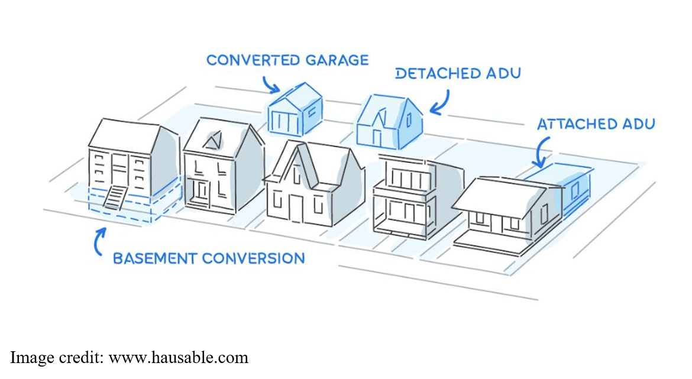
Accessory Dwelling Units: Increasing Our Housing Stock One Unit at a Time
Jennifer Gray, Esq.
Keane & Beane, P.C.
White Plains, NY

Slide 2
Outline
Defining ADUs
Benefits of ADUs
Community Concerns
Local regulation of ADUs
State legislation concerning ADUs

Slide 3
The Rise of the Single-Family Home
Following World War II, society shifted towards suburbanization.
The 1944 authorization of the Veterans Affairs home loan program – part of the GI Bill of Rights – guaranteed millions of loans for single-family homes and mobile homes.
The increase in housing construction following World War II led to the growth of suburban areas.
Single family zoning became the norm

Slide 4
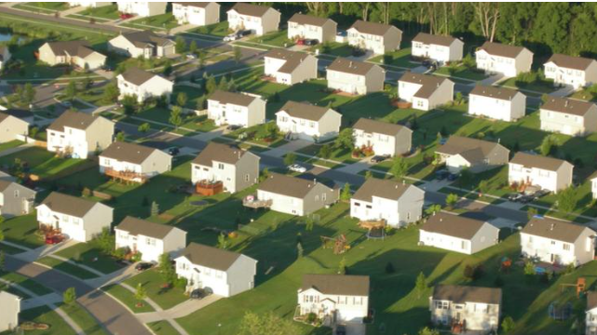
The Future of Single-Family Zoning
Historically, the idea of single-family homes has been embraced by homeowners and local governments across the country to protect neighborhoods from dense development.
A shift away from single-family zoning may be necessary to help address issues concerning housing affordability, demographic diversity and climate change.

Slide 5
What is an ADU?

Slide 6
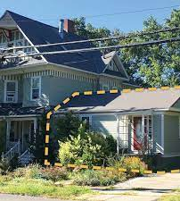
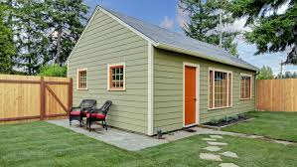
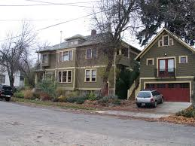
Examples
1. Detached structure
2. Attached to single family home
3. Above garage

Slide 7
Benefits of ADUs
Supplemental income to homeowners
Affordable housing
Increases diversity of housing options
Enable seniors to age in place
Facilitate more efficient use of existing housing stock in established neighborhoods
Smaller ecological footprint than new house construction
Opportunities for young individuals or families

Slide 8
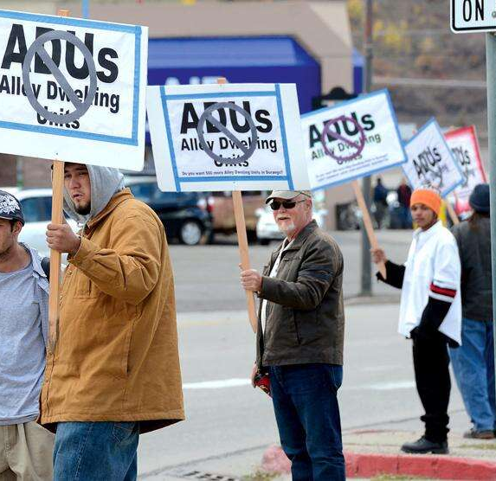
Community Concerns
Changing character of neighborhoods
Overburdening existing infrastructure
Lower property values
Overcrowding
Noise and garbage
Use of ADUs for short-term rentals
Proliferation of unmaintained rentals
Photo by Steve Lewis of the Durango Herald

Slide 9
Planning for Accessory Dwelling Units
Conducting a housing needs assessment before drafting zoning regulations for ADU.
Address ADU in your comprehensive plan.
Amend your Zoning Code to permit accessory dwelling units in single-family zoning districts.

Slide 10
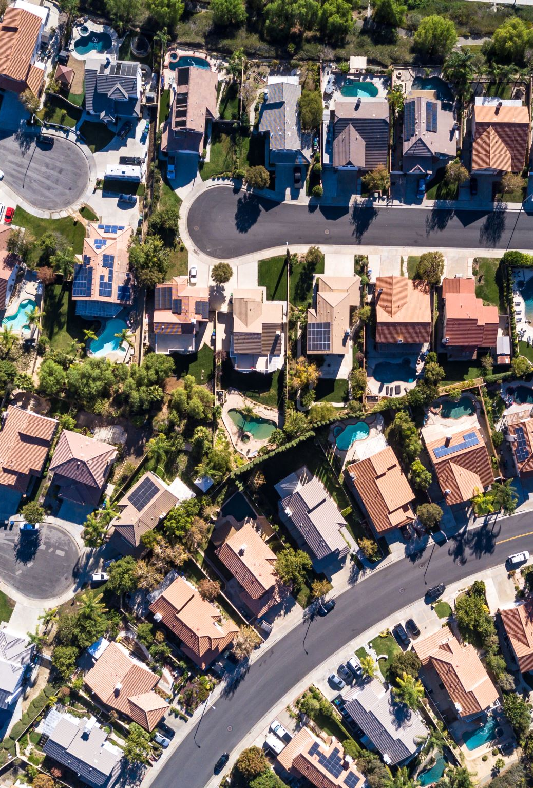
Considerations in Drafting Zoning Regulations
State a clear purpose and intent
Define ADU
Where are accessory dwelling units permitted?
In all residential districts?
On all lots that contain single-family homes?
Owner Occupancy
Special Permit or Site Plan Approval required?
Dimensional and design standards to ensure neighborhood compatibility

Slide 11
More Considerations in Drafting Zoning Regulations
Off-street parking requirements
Minimum lot size
Limits on the number of bedrooms
Minimum and maximum apartment size
Coverage requirements
Setback requirements

Slide 12
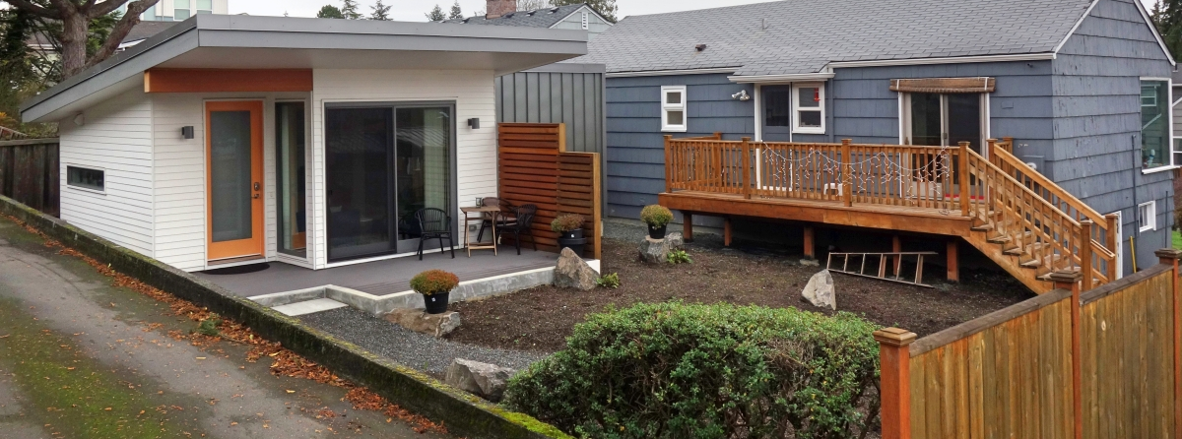
State Initiatives to Promote Accessory Dwelling Units
State lawmakers across the country continue to pursue legislation to encourage development of ADUs.

Slide 13
State-Wide Accessory Dwelling Laws

Slide 14
State-Wide Accessory Dwelling Laws

Slide 15
What’s going on in New York?

Slide 16
New York State ADU Legislation Proposed in 2022
Governor Hochul included an ADU initiative in last year’s Executive Budget
The proposal mandated local governments pass legislation allowing ADUs
The Governor argued it was partly intended to legalize and bring up to code illegal apartments in single-family homes
The proposal was removed after lawmakers raised concerns with its potential impact on local zoning laws

Slide 17
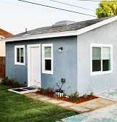
Plus One ADU Program
2022-2023 NYS Capital Budget made available $85M to create and repair ADUs across the State
NY Department of Housing and Community Renewal
Provides grants of up to $10M to partnership teams of local governments and NFP organizations who then provide assistance to low- to moderate-income individuals to construct or repair an ADU.
Assistance of up to $125,000 available

Slide 18
Proposed Legislation in the Senate and Assembly

Slide 19
Accessory Dwelling Unit Incentive Act
A01401
Introduced and referred to housing on January 17, 2023
The purpose of this bill is to establish financial incentives to create accessory dwelling units.
The act creates a forgivable loan program, an income tax credit, and a real property tax exemption to incentivize property owners to construct accessory dwelling units where such units are permitted.

Slide 20
Affordable Housing Plans
A02017
Introduced and referred to local governments on January 23, 2023
The purpose of this bill is to direct local governments to prepare a plan to help meet the affordable housing needs of their community and region.
The bill will require local governments to craft and enact comprehensive five-year plans to address the local and regional lack of affordable housing and the appropriate solutions deemed necessary.

Slide 21
445 Hamilton Ave | White Plains, NY 200 Westage Business Center | Fishkill, NY
www.kblaw.com 914/946-4777 | 845/896-0120
For Further Information
Jennifer Gray, Esq.
Jgray@kblaw.com

