Slide 1
Financing Small
Rental Projects
Presented by
MM Development Advisors, Inc.
Monica C. McCullough, Esq., MPA
for
Rural Housing Coalition
June 30, 2022

Slide 2
Topics
Supportive Housing
Community Development
Subsidy Only
Notes:
For each:
Program
Example
Pitfalls

Slide 3
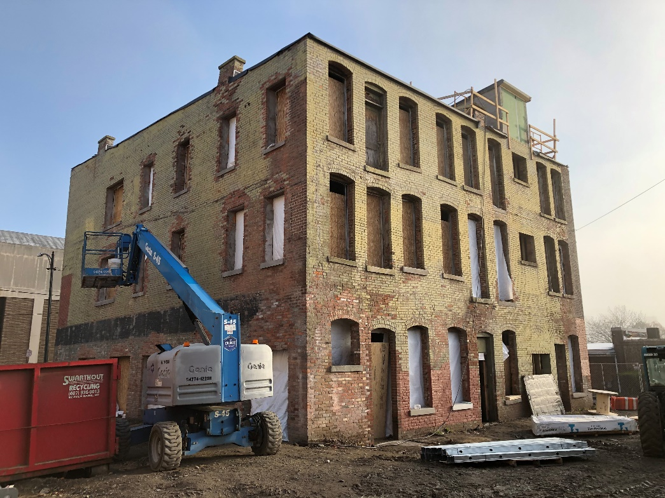
Defining “Small”
Supportive Housing – up to 20 units
LIHTC – approximately 20-30 units
Subsidy Only – term sheet dependent

Slide 4
What is Affordable Housing?
Housing that is subject to a
regulatory agreement
with imposes an
income restriction
on the market of tenants

Slide 5
Income Restrictions
Measured as compared to
“Area Median Income” (AMI)
Common limits: 30% of AMI
50% of AMI
60% of AMI

Slide 6
Area Median Incomes (2020)
1 Person Household
AMI 50% AMI
Buffalo MSA $54,400 $27,200
Rochester MSA $53,500 $26,750
Albany MSA $67,900 $33,950
Allegany Co. $47,100 $23,550
New York City $79,600 $39,800
San Francisco $121,800 $60,900
Notes:
2020 values, effective March 2021;
All locations above increased over 2019

Slide 7
Affordable Rents
Affordable monthly housing cost limit for one person household in Rochester at 50% AMI:
$53,500/2 = $26,750 x 30% = $8,025/12 = $669
The market always sets the absolute maximum rent/income limit.

Slide 8
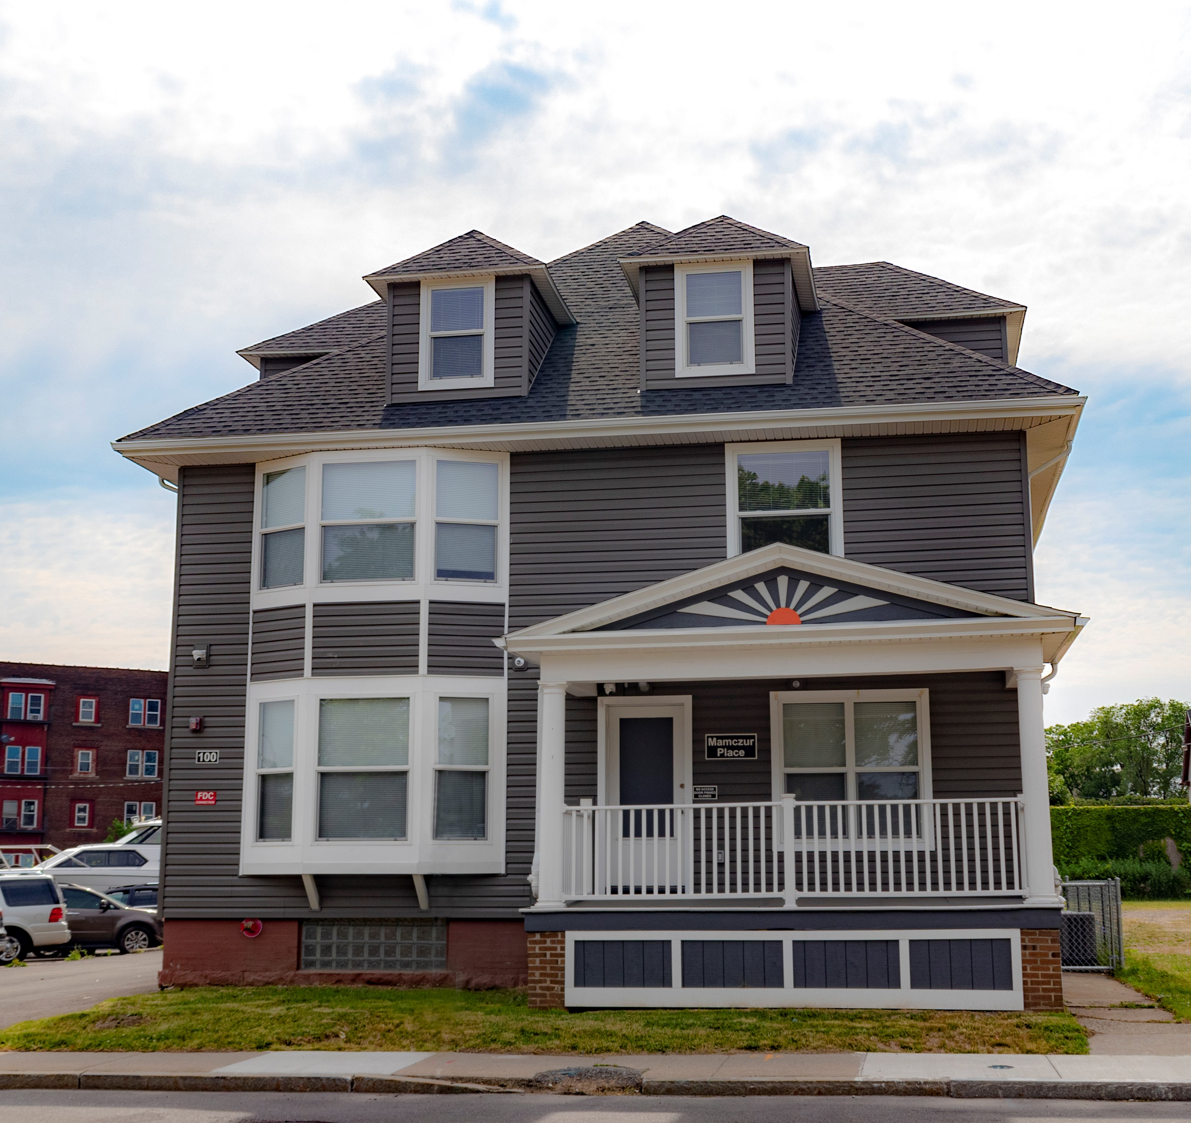
Supportive Housing
HHAP Capital + ESSHI Operating Subsidy

Slide 9
Supportive Housing
Must create new units of supportive housing
NFP must be the applicant
Must serve homeless population (State definition), rent charged can be no more than 30% of HH income, must provide supportive services
25-year regulatory period – after this, loan is forgiven
ESSHI operating subsidy adds special need population requirement (SMI, SUD, etc.)

Slide 10
Supportive Housing
Should identify other capital funding sources for leverage, if possible
Very limited developer/consultant fee – but very limited risk
Cost estimating at the time of application is critical as there is little to no wiggle room/cushion to absorb cost escalation

Slide 11
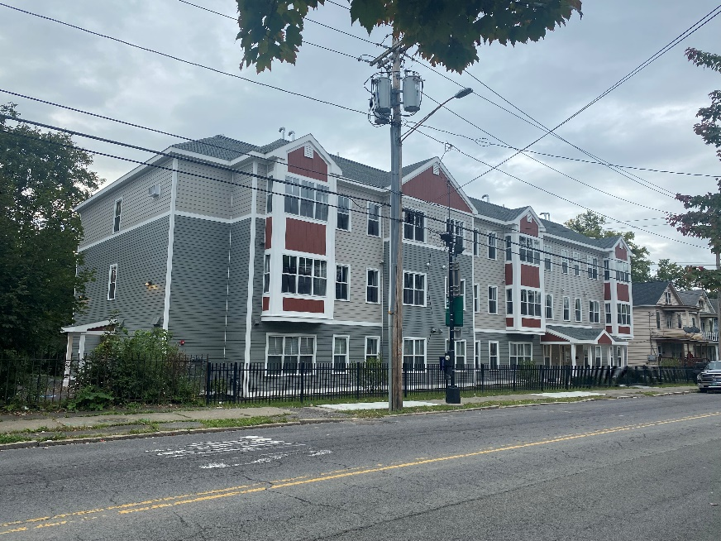
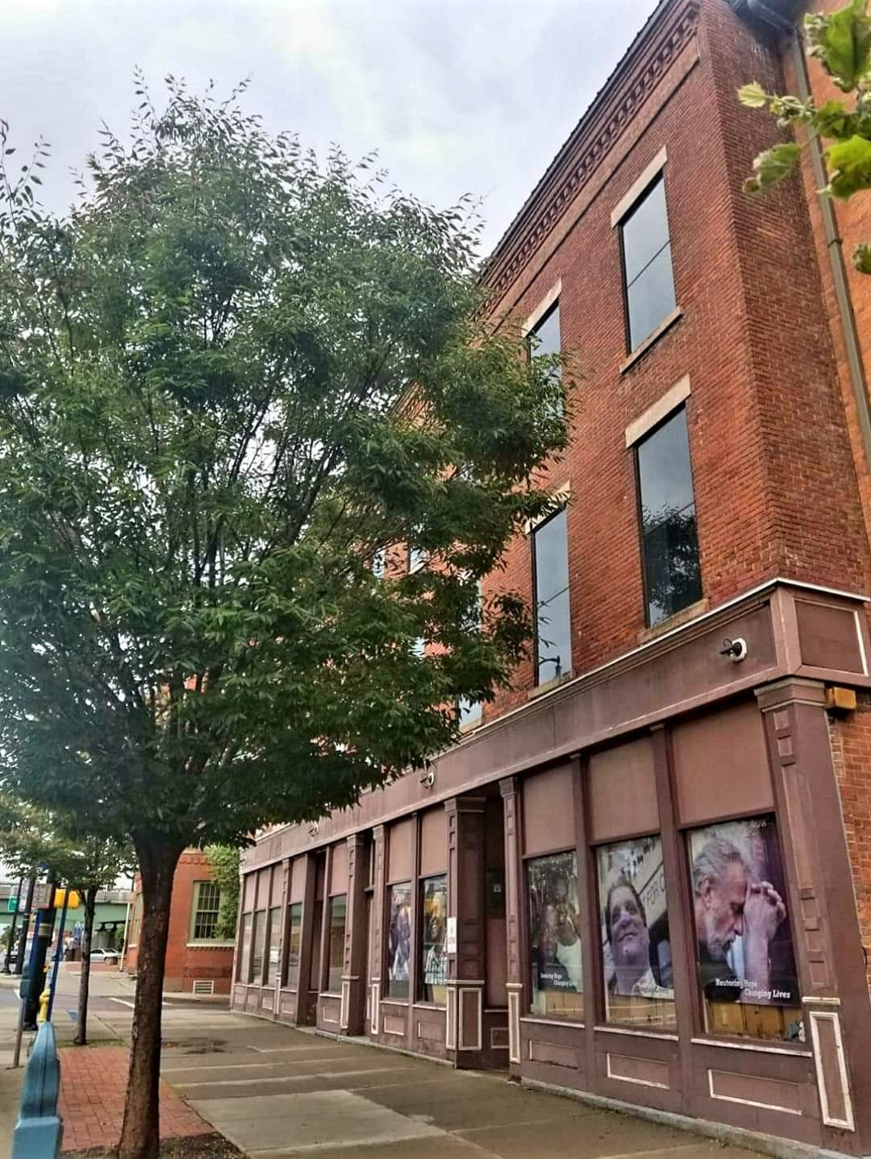
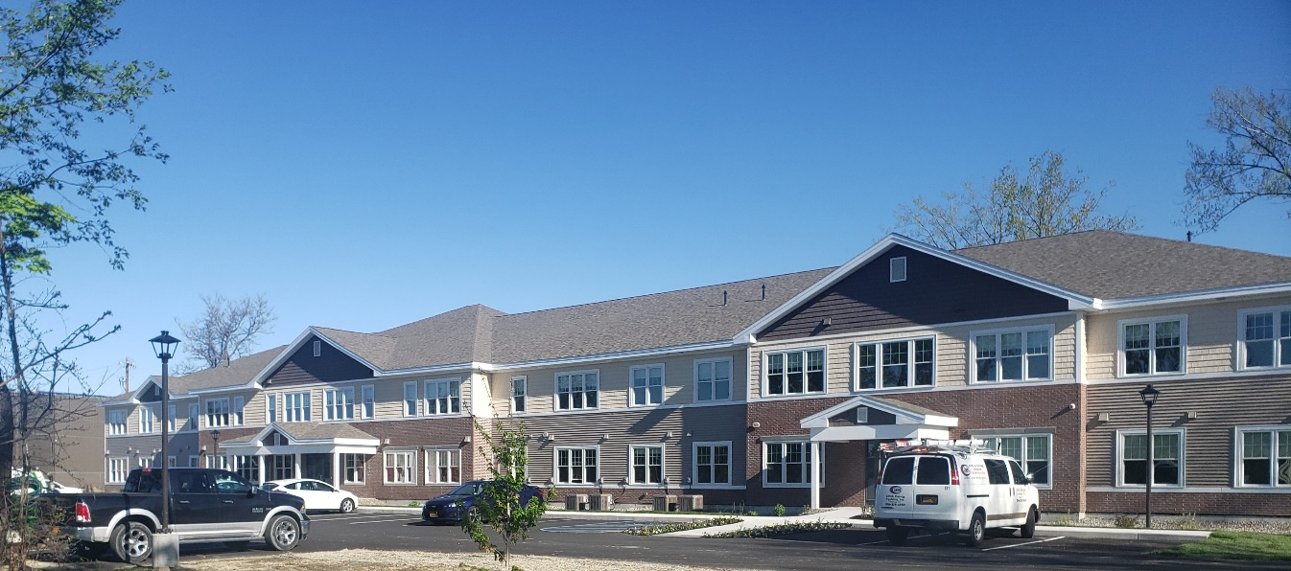
Supportive Housing

Slide 12
Community Development with LIHTC
9% Low Income Housing Tax Credits (LIHTCs) + Subsidy
A 9% tax credit project does not need to be 60 units. There is no magic formula.

Slide 13
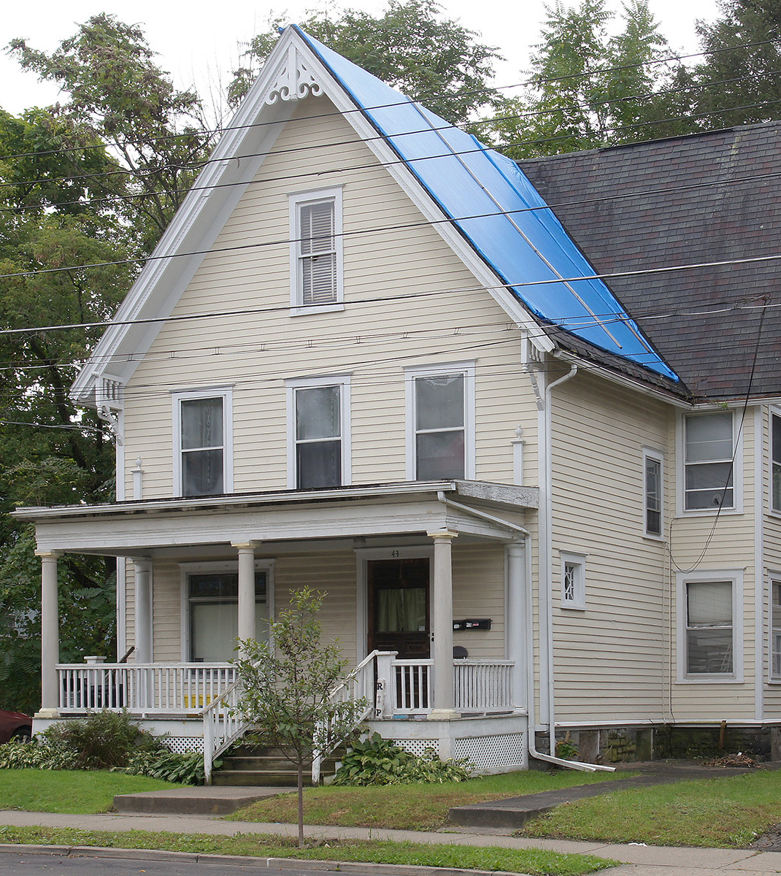
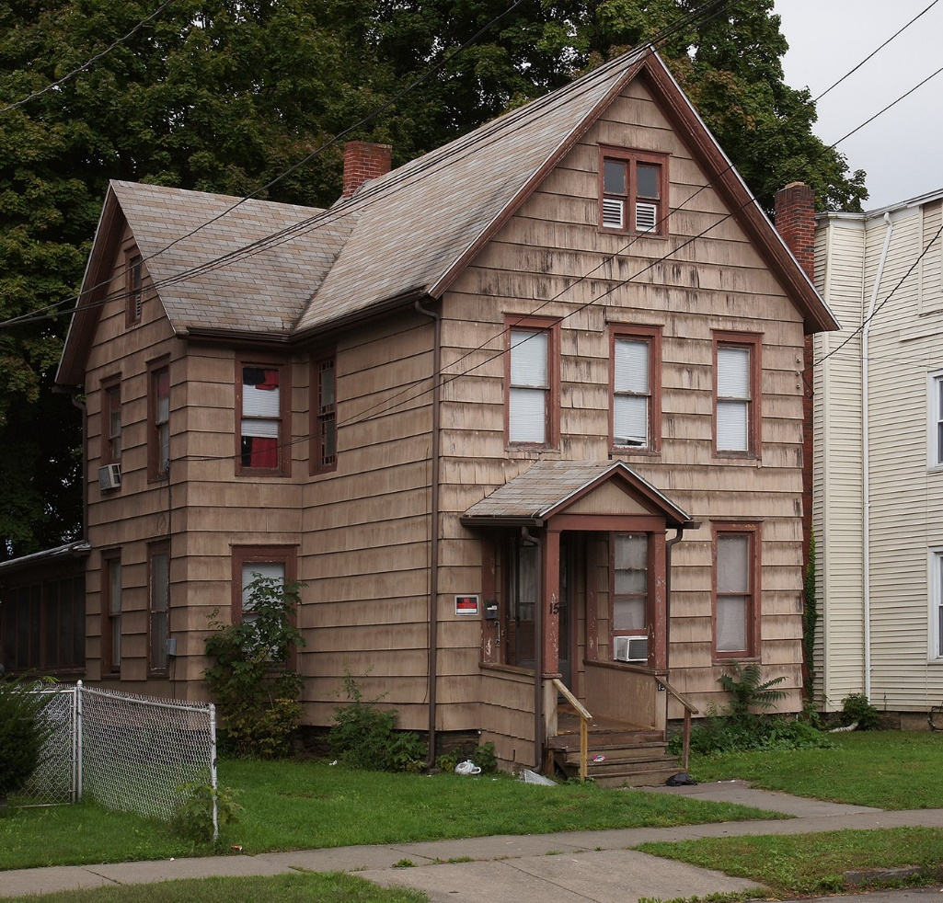
Community Development with LIHTC

Slide 14
Community Development with LIHTC

Slide 15
Community Development with LIHTC
9% LIHC – highly competitive
Most recently, 2x year RFP
Must meet a state housing goal to apply – can be challenging for small, community development projects
New construction or rehab
Pairs easily with historic rehab

Slide 16
Community Development with LIHTC
Technically difficult – experience matters and need for partner/consultant
Operational efficiency – size matters
Site control and Land Use/Zoning
Operating pressure – low rents/high costs
Small projects in small communities have limited investor pool
Residual value issue – upside down debt
in year 30

Slide 17
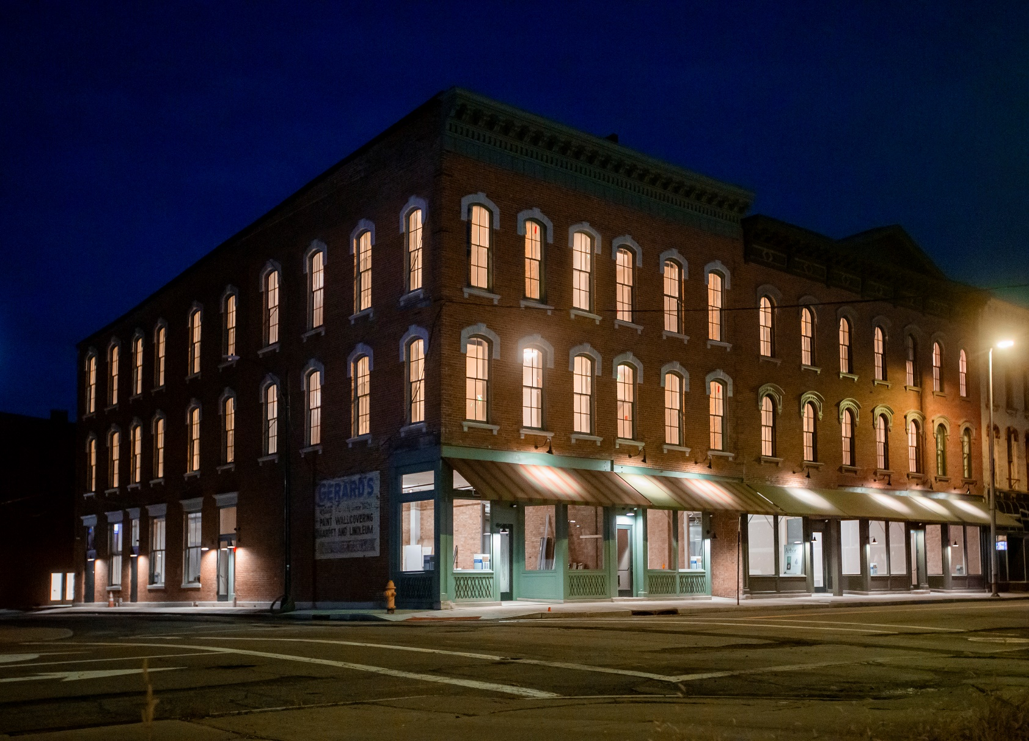
Community Development with LIHTC

Slide 18
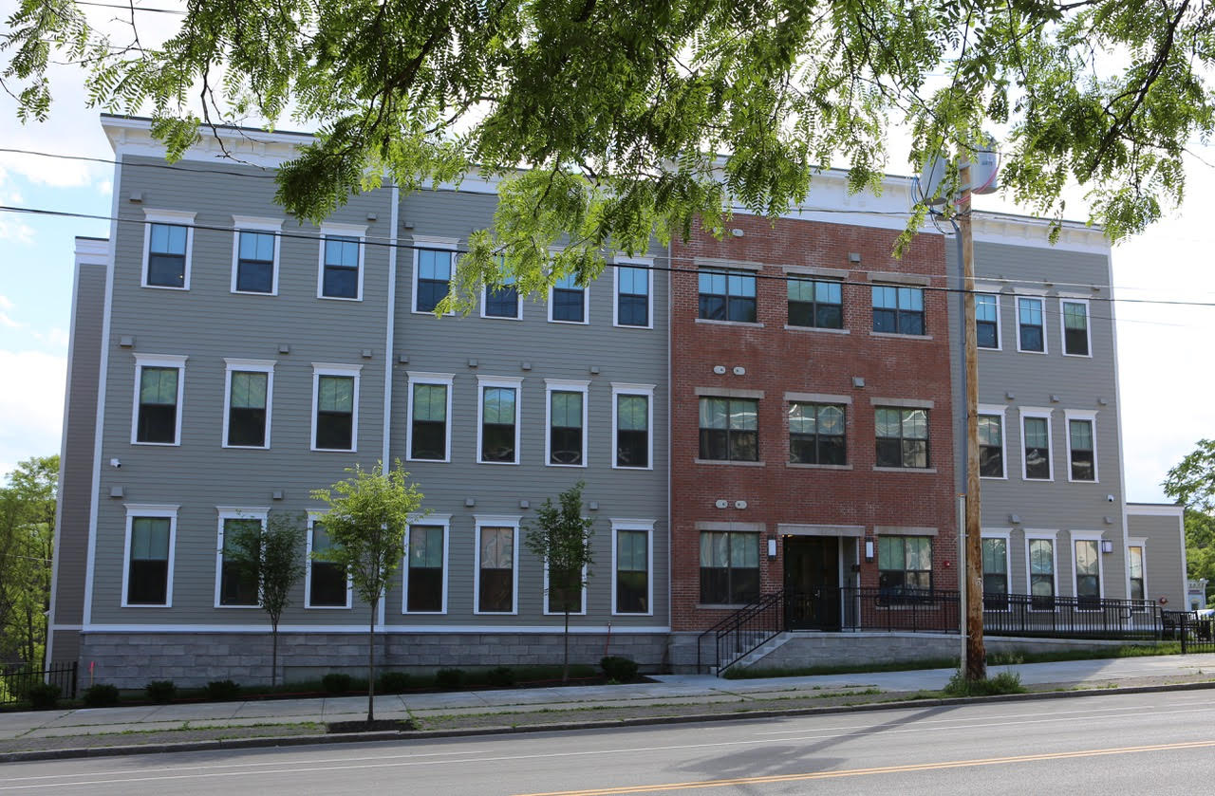
Subsidy Only
HOME, HDF, HTF, CIF (mixed use), etc.
Programs and term sheets vary by and change year to year
ESD Sources
SRDI

Slide 19
Subsidy Only
Beware of perm only funding sources – this will drive need for construction loan
HCR is generally not set up to be an efficient construction lender
Limitations on eligible expenses – fee, working capital, reserves, acquisition, some soft costs
Limited fee revenue/high risk – little to no cushion to absorb cost fluctuation
Rarely – never?! – can a project be completed with just one subsidy source
Highest likelihood of permanent sponsor
financial loss/contribution/“loan”

Slide 20
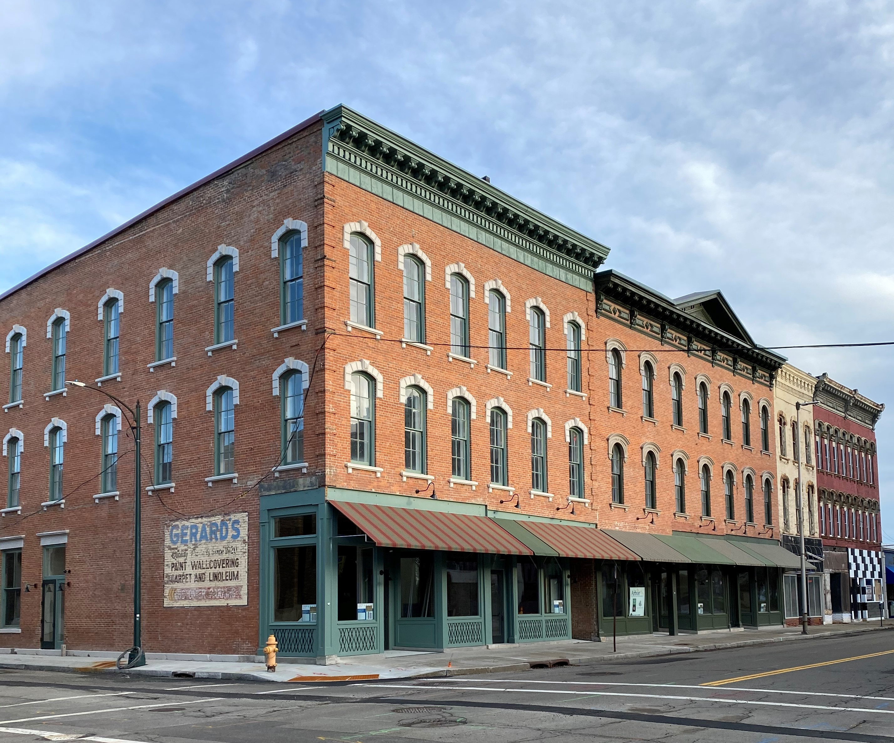
Contact Info
monica@mmdevelopmentadvisors.com
315.559.3181
www.mmdevelopmentadvisors.com
(Resources Tab & Project Examples)

